Slide 1

Breaking Uncertain or Unexpected news:
A Practical Workshop for Sonographers
BMUS Annual Scientific Meeting: Ultrasound 2024
Webinar: 11th December 2024, 10:30-12:30
Facilitators: Dr Una MacFadyen and Kate Stanton

Slide 2
Section 1:
Section 2:
Section 3:
Section 4:
Section 5:
Welcome and introduction to Sands
Introduction to pregnancy loss, baby death and perinatal bereavement care
The cognitive memory making process and the effects of trauma on the brain
Break
“Thinking outside the memory box”
Lunch break
Memory making with bereaved parents
Break
Taking care of yourself
Transforming memory-making: from an isolated postnatal activity to a continuous, and conscious consideration throughout the bereavement care journey
Practical Workshop
Reflection and evaluation
Programme
Welcome and introduction
Psychological Impact of Trauma: Understanding Reactions
Breaking bad news with sensitivity and compassion
Taking care of yourself
Reflection and evaluation
Section 1:
Section 2:
Section 3:
Notes:
Read Course Programme from slide

Slide 3


Dr Una MacFadyen
Consultant Paediatrician and Neonatologist (retired) and Medical Adviser to SOFT UK
Kate Stanton
Qualified Integrative Counsellor, Paediatric Nurse (specialising in end-of-life care), and Sands Trainer
Notes:
Opportunity to introduce yoursleves

Slide 4



Before we begin…
Difficult and emotional content
Varied experiences: personal and professional
Self-care and breaks
SANDS helpline
Value of real experiences
Kindness and respect
Safe and supportive space
Thank you for you dedication to this important work.
Take care of yourself
Helpline Support
0808 164 3332
helpline@sands.org.uk
Notes:
Before We Begin…
Difficult Content: This session will discuss some tough and emotional topics related to baby loss and bereavement.
Different Experiences: I am aware that everyone has different personal and professional experiences, and I hope that our discussion don’t cause upset to anyone.
Self-Care: If you feel overwhelmed at any time, please take a break. It’s okay to step away if you need to.
Support Resources: Remember, the SANDS helpline and email support are available for anyone who needs extra help (contact details on screen).
Value of Sharing: Sharing real experiences can help everyone improve their practice, so feel free to be open, but only if you feel comfortable doing so.
Be Kind and Respectful: Please treat each other with kindness and respect throughout the session to create a supportive environment.
Safe Space: We aim to create a safe and supportive online space for learning about bereavement care.
Thank You: Thank you for your dedication to this important work. We appreciate you being here today! But please take care of yourself throughout the session.

Slide 5

Think about your experiences of breaking uncertain or unexpected news.
What are your main concerns?
Notes:
An opportunity for the participants to share their concerns about breaking uncertain or unexpected news.
An opportunity to discuss concerns and identify opportunities throughout the session to address some of the concerns.

Slide 6

What we hear from professionals…
"I don’t want to say the wrong thing and make an already difficult situation worse.“
"I don't know how to discuss uncertain or unexpected results without overwhelming parents.“
"I’m afraid what I say might sound rehearsed or insincere.“
"I'm worried I won't know how to explain findings without causing distress.“
"I'm concerned I’ll become too emotional and struggle to maintain my professionalism.“
Notes:
Opportunity to reassure participants that their concerns are common and valid….
What We Hear from Sonographers...
Common Concerns:
"I'm worried I won't know how to explain findings without causing distress.“
"I don’t want to say the wrong thing and make an already difficult situation worse.“
"I don't know how to discuss uncertain or unexpected results without overwhelming parents.“
"I’m afraid what I say might sound rehearsed or insincere.“
"I'm concerned I’ll become too emotional and struggle to maintain my professionalism.“
Sonographers may worry about inadvertently worsening the parents' experience by using inappropriate language, providing too much or too little information, or misjudging how to address emotional reactions. Concerns about staying composed and managing their own emotions—such as the fear of becoming tearful or struggling to speak—are also common.
How Training Can Help: Training can build confidence and provide practical communication strategies for sonographers. These sessions help professionals navigate the delicate balance of conveying information with empathy, recognizing the impact of their words, and ensuring parents feel supported during difficult or unexpected scan results.

Slide 7

Section 1
Psychological Impact of Trauma: Understanding Parents' Reactions
Understanding the Factors Influencing Parental Responses
The Impact of Bereavement and the Importance of high-quality Trauma-Informed Care
Notes:
Total: 45 mins: 12:00 to 12:40
20 minutes - slide presentation
20-minute - group activity
Session 3: Breaking Bad News with Sensitivity and Compassion
Principles of Breaking Bad News: Guidelines for delivering difficult news with care and compassion.
Managing Reactions: Strategies for responding to various emotional reactions from parents.
Saying Sorry: The importance of acknowledging the loss and expressing genuine empathy.
Effective and Sensitive Delivery of Bad News: A 3-step process for delivering bad news in a manner that respects the emotional needs of parents.
GROUP ACTIVITY

Slide 8
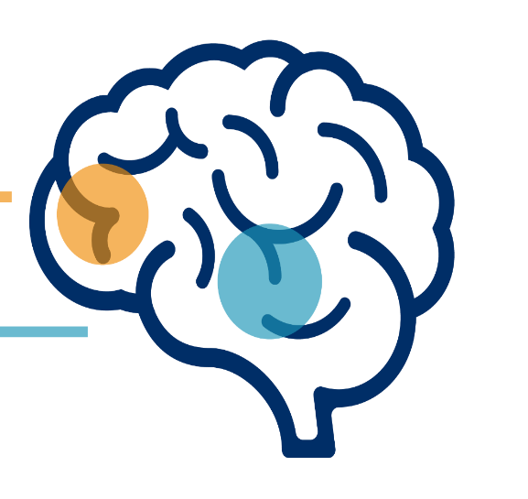

Psychological Impact of Trauma: Understanding Parents' Reactions
During stressful events, our brain behaves differently
“Learning / thinking brain”
(Prefrontal Cortex)
Switches OFF
“Primitive/ emotional Brain”
(Limbic system)
Switched ON
Brain goes into survival mode (fight/flight/freeze)
“Brain fog”
Prefrontal cortex
Limbic
System
Rational and logical thinking
STRESS HORMONES
(Cortisol/ Adrenaline)
“FEEL GOOD”
HORMONES
(Dopamine/ Oxytocin)
Emotional
thinking
Normal State
EFFECTIVE
Thinking, decision making and memory-making ability
IMPAIRED
thinking, decision making and memory-making ability
“Feel-Good” Hormones
“Stress” Hormones
“Feel-Good” Hormones
State of Trauma
Notes:
As we explore breaking uncertain or unexpected news, it’s important to understand the psychological effects of the news on parents:
Normal Cognitive Function: Under normal circumstances, the prefrontal cortex of the brain manages rational and logical thinking, learning, and memory, supported by ‘feel-good’ hormones.
Impact of Trauma: Traumatic events, such as the loss of a baby, disrupt normal brain function by increasing stress hormones and depleting “feel-good hormones, impairing happiness and clear thinking.
Survival Mode: In response to trauma, the emotional brain (limbic system) takes over, causing the brain to enter survival mode: Fight, Flight, or Freeze!!
Understanding Parents' Reactions in "Survival Mode“
When parents receive distressing or unexpected news during an obstetric scan, their brain may shift into survival mode, driven by the fight, flight, or freeze response. This can profoundly influence their communication and decision-making.
Examples Relevant to Sonography:
Fight (Defensiveness/Anger): A parent might respond with frustration or anger, saying,
“Why are you telling me this? Are you sure you even know what you’re looking at?”
This can reflect their emotional overwhelm and a need to assert control.
Flight (Avoidance/Deflection): A parent may attempt to disengage from the conversation, saying,
“I think I need some air. Can we stop for now and talk about this later?”
This reaction may indicate an effort to escape the emotional weight of the situation.
Freeze (Unresponsive/Inarticulate): A parent might appear stunned or struggle to articulate their feelings, saying,
“I... I don’t know... What does this mean?”
They might seem unable to process the information being shared.
How to Respond Compassionately:
Recognise Natural Responses: Understand these reactions are protective, not personal.
Simplify Communication: Use clear, non-technical language and avoid overwhelming parents with too much information at once.
Empathy and Space: Offer emotional support, reassure parents, and give them time to process the news.
Provide Takeaway Materials: Written notes or resources can help parents retain and reflect on the key points later.
Emotional Challenges (Brain Fog): Trauma often impairs memory, decision-making, and cognitive clarity. Be prepared to repeat information and provide support for parents to navigate these difficulties.
Communication Tips:
Acknowledge Grief's Impact: Recognise that trauma affects their ability to retain information.
Be Patient and Gentle: Take time to ensure understanding.
Provide Clear Support: Offer emotional reassurance and practical guidance.
This framework helps healthcare professionals, especially sonographers, deliver difficult news in a compassionate and supportive manner, ensuring parents feel cared for during distressing times.

Slide 9

Understanding the Factors Influencing Parental Responses
Socioeconomic Factors:
Education
Occupation
Wealth
Unique Experiences and Tailored Care
Common themes
Individual and unique experiences shaped by diverse backgrounds
Role of a healthcare professional:
Sensitivity to diversity
Person-centred care
Compassionate communication
Adaptability
Health Factors:
Physical Health
Mental Health
Personal Factors:
Culture
Religion
Personal Beliefs and Values
Support Factors:
Family:
Community
Support Network
Demographic Factors:
Gender
Age
Ethnicity
Notes:
Factors Influencing How Families Experience and Process Unexpected News
Socioeconomic Factors:
Access to Healthcare: Parents' ability to access timely and quality care can affect their experience and understanding of uncertain or bad news.
Resources and Support: Financial and social resources influence coping mechanisms and access to support services.
Personal Factors:
Culture and Religion: Cultural and religious beliefs shape how families perceive and process the situation, including grief or hope.
Values and Beliefs: Each family's unique outlook and values affect their preferences and decisions in response to the news.
Demographic Factors:
Gender and Age: Parents' experiences and emotional needs may differ based on these factors, influencing how they process and communicate their feelings.
Ethnicity: Ethnic backgrounds may shape family expectations and attitudes toward communication, care, and decision-making.
Support Factors:
Family and Community: Strong support systems, whether from family or community groups, can provide critical emotional and practical help.
Healthcare Professionals: The compassion, empathy, and communication skills of sonographers and other caregivers play a vital role in supporting families.
Health Factors:
Physical Health: Parents' physical well-being can influence their resilience and ability to cope.
Mental Health: Emotional and psychological states significantly affect how parents process and respond to uncertain or distressing news.
Unique Experiences and Tailored Care
Individual Experiences: While families may share common themes of grief, uncertainty, or hope, every journey is unique and shaped by their distinct backgrounds and circumstances.
Role of Healthcare Professionals
Sensitivity to Diversity: Healthcare professionals must be sensitive to the diverse perspectives, values, and beliefs of families, providing care that respects and aligns with their needs.
Person-Centered Care: Tailor communication and care to align with each family's individual background, values, and needs.
Compassionate Communication: Deliver news with empathy, clarity, and sensitivity, ensuring parents feel supported and understood.
Adaptability: Recognize and adapt to cultural, religious, or personal factors that influence how families perceive and respond to care.

Slide 10
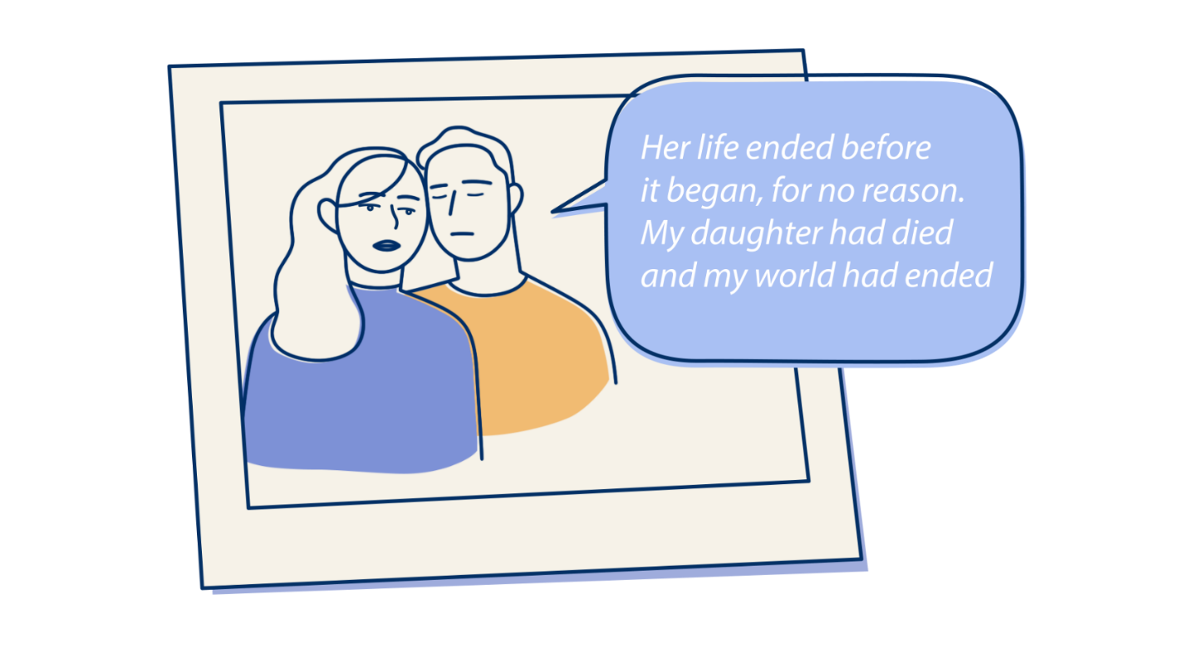
The Impact of Bereavement and the Importance of Trauma-Informed Care
Emotional Responses: Shock, grief, trauma, disbelief, and emotional numbness are common reactions for bereaved parents.
Mental Health Risks: Bereaved parents are more susceptible to developing mental health conditions such as depression, anxiety, post-traumatic stress, and phobias.
Long-Lasting Impact: Words and actions by healthcare professionals are remembered in detail and can significantly influence parents' well-being.
Trauma-Informed Care: High-quality, trauma-informed bereavement care can help mitigate both immediate and long-term negative effects on parents.
Notes:
What research tell us:
Parents often experience shock, grief, trauma, disbelief, and emotional anaesthesia following the loss of a baby.
Bereaved parents are more susceptible to developing mental health conditions such as depression, anxiety, post-traumatic stress, and phobias.
What you say and do during this time will be remembered by parents in detail and can have a lasting impact on their well-being.
Developing and embedding high-quality trauma-informed bereavement care into your practice has been shown to moderate both immediate and long-term negative outcomes for bereaved parents.
Research:
Boyle et al. 2020. Clinical practice guidelines for perinatal bereavement care — An overview. Women and Birth. 33. 207-210.
Ellis, A. 2016. Systematic review to understand and improve care after stillbirth: a review of parents’ and healthcare professionals’ experiences. Pregnancy and Childbirth. 16:16.
Garcia, R. et al, 2020. A qualitative study exploring the experiences of bereavement after stillbirth in Pakistani, Bangladeshi and white British mothers living in Luton, UK. Midwifery. 91.
Hughes et al. 2013. Perinatal bereavement care: Are we meeting families’ needs? British Journal of Midwifery. VOL:21.4. 248-253.
Pollock et al. 2020. Pregnancy after loss during the COVID19 pandemic. Women and Birth. 33.540-543.
Shakespeare, C. et al. 2020. The RESPECT Study for consensus on global bereavement care after stillbirth. International Journal of Gynaecology and Obstetrics. 149.137-147.
Smith et al. 2020. Parents’ experiences of care following the loss of a baby at the margins between miscarriage, stillbirth and neonatal death: a UK qualitative study. International Journal of Obstetrics and Gynaecology. Online.
The Body Keeps the Score, 2015, Bessel van der Kolk

Slide 11
Section 4
Breaking news with sensitivity and compassion
Principles of breaking bad news
When the news may not be so bad - At the 19-week anomaly scan
Effective and sensitive delivery of bad news: A 3-step process
Case study exercises
Managing reactions with empathy
Notes:
Total: 45 mins: 12:00 to 12:40
20 minutes - slide presentation
20-minute - group activity
Session 3: Breaking Bad News with Sensitivity and Compassion
Principles of Breaking Bad News: Guidelines for delivering difficult news with care and compassion.
Managing Reactions: Strategies for responding to various emotional reactions from parents.
Saying Sorry: The importance of acknowledging the loss and expressing genuine empathy.
Effective and Sensitive Delivery of Bad News: A 3-step process for delivering bad news in a manner that respects the emotional needs of parents.
GROUP ACTIVITY

Slide 12

“The bad news about breaking bad news is that it is never easy; doing it well is always an uncomfortable act” (Noble 1991)
Notes:
"Do you want the good news or the bad news?
1. The bad news about breaking bad news is that it is never going to be easy.
It is always going to be an incredibly difficult situation for all involved.
Doing it well is always going to be uncomfortable.
But doing it badly can have long-term implications for the family and yourself.
2. The Good News: By the end of this session, you’ll have some practical tools to help you navigate these conversations with greater confidence and compassion. Doing it well can make a world of difference—for the parents, who will feel supported and cared for in their darkest moments, and for you, as you see the positive impact of your empathy and professionalism.
As one parent reflected: "I could see how difficult it was for the healthcare professional, but their compassion showed me they truly cared."
The bad news about breaking bad news is that it is never easy; doing it well is always an uncomfortable act
(Noble 1991) Are nurses good patient educators? Caroline Noble RGN

Slide 13
Support
Compassion & Empathy
Understanding
Body language
Time
Breaking Bad News
The Seven Principles
Clarity
Setting
Notes:
To effectively support parents experiencing difficult situations, healthcare professionals should prioritise compassion, empathy, support, understanding, time, appropriate setting, clarity, and body language. Here's how to apply these principles:
Compassion and Empathy: Be warm, genuine, and use sensitive language to convey empathy and understanding towards parents.
Support: Assess if parents are alone and inquire about available support resources. If needed, consider reaching out to someone for additional assistance or support.
Understanding: Recognize the diversity of interpretations and neurodiverse needs among parents. Tailor communication and support strategies accordingly.
Time: Allow parents sufficient time and space to process their emotions and thoughts. Avoid rushing or pressuring them to make decisions.
Setting: Select an appropriate and comfortable setting for discussions, ensuring privacy and minimising distractions.
Clarity: Be clear, open, and honest in communication with parents, providing information in a straightforward manner while acknowledging the emotional sensitivity of the situation.
Body Language: Use non-verbal cues such as maintaining eye contact and sitting down to convey attentiveness, respect, and openness.
Remember that applying these principles may be challenging, especially in emotionally charged situations. Confidence in implementing them comes with experience. Consider using these principles as a basis for reflection and debrief exercises to enhance practice and self-awareness.

Slide 14

A Parent’s Perspective:

Slide 15
When the news may not be so bad
At the anomaly scan
19 weeks

Slide 16
Being prepared
The environment
The team
The schedule
Yourself
Your backup plan
Your local services
Sharing learning
Feedback/debriefs
Support groups

Slide 17
Knowing yourself
How others see and hear you – greeting, introductions
Your past experiences – in life and at work
Your use of words/dialect - when they will be remembered
Your professional jargon
Your relationship with line manager and colleagues
Your behaviour under stress

Slide 18


Expectations
What do parents expect from this scan?
Do parents understand your role?
Any anomaly is often all that registers
Parents visualisations vary

Slide 19
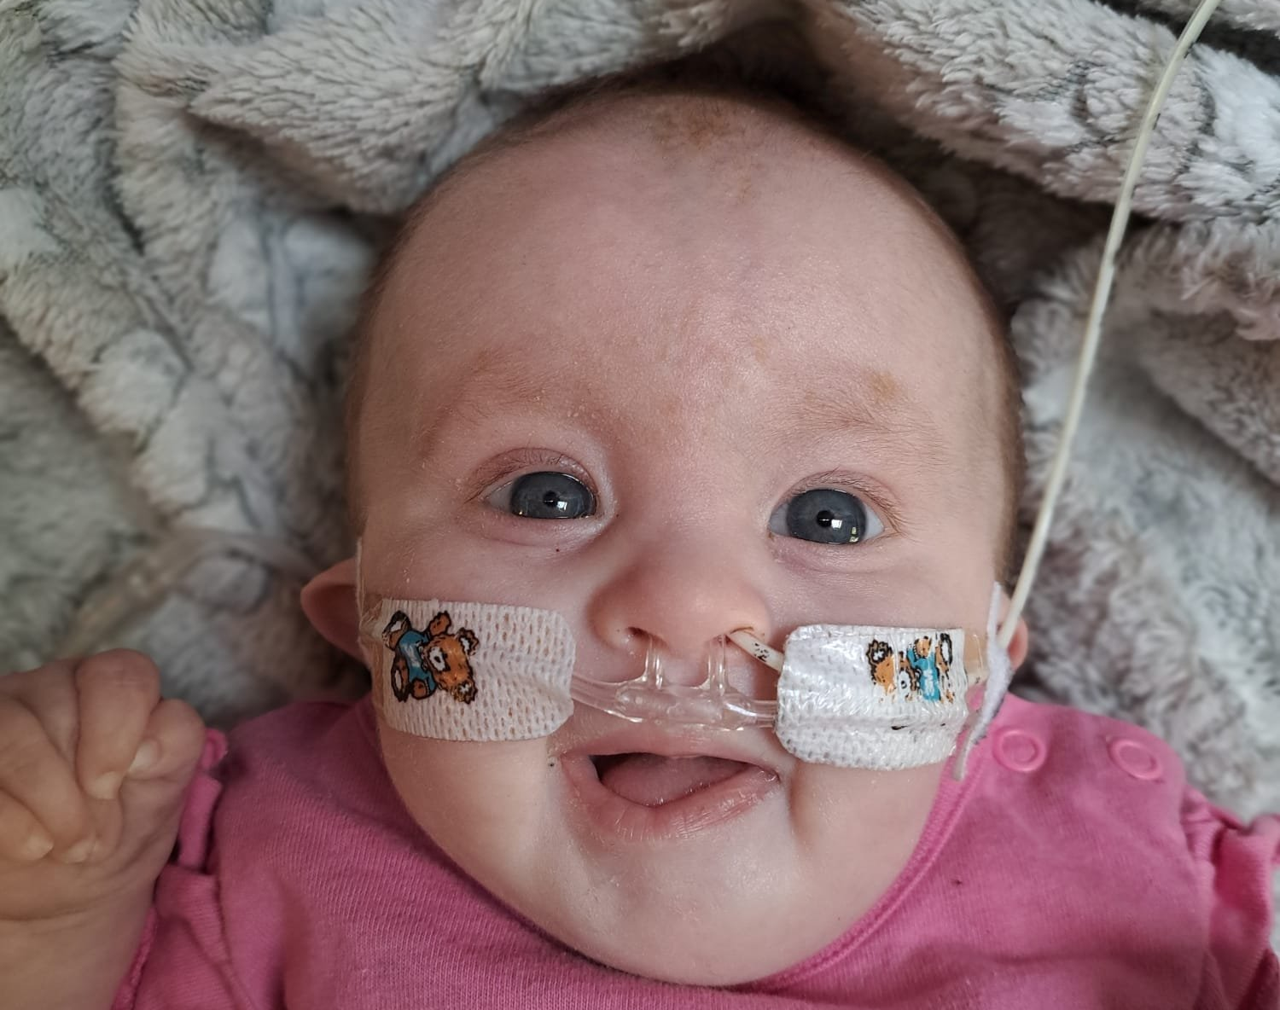
Uncertainty
Every fetus/baby/parent/healthcare professional is an individual
Every individual brings their own cultural background
Every individual communicates in their own way – non-verbal and verbal

Slide 20
Tips for your brief encounter learning from those who have been there before
Know and use both parents' names
Professionalism:
empathy means walking beside not 'knowing how they feel' and it can be learnt – showing concern is welcome when genuine but not overwhelming
leave your home pressures in your 'big bag of worries'
Use words that work for you, check they are understood (and repeat as often as needed), they will be remembered.
Don't generalise, be aware if cultural differences ask don't guess
Be sorry that you have changed expectations but you don't have to have all the answers, saying 'don't know' but can still help and support them is enough and is remembered.

Slide 21


Sympathy versus empathy
Sympathy
Empathy
The ability to understand and share how others are feeling and respond in a supportive way, while keeping enough distance to avoid feeling overwhelmed by their emotions.
To feel sorry for someone else's grief or loss. While you show sadness, you keep your own feelings separate from theirs.
Disconnection
Connection
Notes:
Understanding the difference between sympathy and empathy is important when helping parents who are grieving.
Sympathy means feeling sorry for someone else's loss, which keeps your feelings separate from the grieving person.
This can make parents feel alone and disconnected, as they might not get the support they need.
On the other hand, empathy involves really understanding and sharing how someone else feels.
This allows the supporter to be kind and helpful without getting overwhelmed by their own emotions.
By showing empathy, grieving parents can feel more understood and less alone, creating a connection that helps ease their anxiety and encourages them to share their thoughts and feelings.
Fostering empathy in our interactions with bereaved parents is essential for their healing. By prioritizing empathy over sympathy, we can significantly improve their experience during this challenging time.

Slide 22
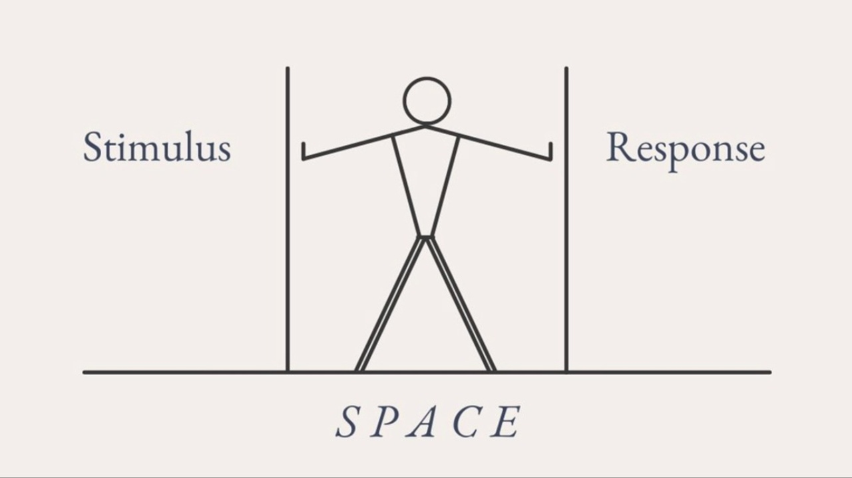

Power of “The Pause”
Between stimulus and response, there is space. In that space is our power to choose our response. In our response lies our growth and our freedom.
Viktor E. Frankl
Notes:
The Power of Pausing in Healthcare Conversations
For healthcare professionals, pausing is a vital tool when having sensitive conversations with parents experiencing pregnancy loss or the death of a baby. Viktor Frankl’s idea of the "pause" provides valuable guidance for offering compassionate and effective support.
The Power and Benefits of Pausing in Healthcare Conversations
The Power of the Pause
A critical tool for healthcare professionals in sensitive conversations with bereaved parents.
Inspired by Viktor Frankl’s philosophy, the pause offers the freedom to choose your response, helping you grow as both a professional and a person.
Growth: A pause allows space to reflect and respond thoughtfully, building empathy and emotional resilience.
Freedom: It empowers you to choose your response based on your values and the needs of the parent, fostering compassionate care.
Benefits of Pausing
Compassionate Space: Creates a space for thoughtful, caring responses.
Calms Emotional Responses: Allows you to manage emotions and avoid impulsive reactions.
Supports Thoughtful Responses: Enables you to choose words that are empathetic and supportive.
Builds Trust: A well-timed pause shows active listening, reassuring grieving parents they are being heard.

Slide 23





Practical Steps for Implementing ‘The Pause’
Take Deep Breaths:
Calm your mind and body before responding.
Listen Actively:
Focus on truly listening without planning your response.
Reflect Before Responding:
Allow a moment of silence to reflect on their words.
Validate Emotions:
Acknowledge the parents’ pain and loss.
Choose Words Carefully:
Think about the impact of your words before speaking.
Notes:
Practical Steps for Implementing the Pause:
Take Deep Breaths: Before responding, take a few deep breaths to calm your mind and body.
Listen Actively: Focus on truly listening to the parents without planning your response while they are speaking.
Reflect Before Responding: Allow a moment of silence after they have spoken to reflect on their words and emotions.
Validate Emotions: Use the pause to validate the parents’ emotions, acknowledging their pain and loss.
Choose Words Carefully: Think about your words and their impact before speaking, aiming for empathy and support.

Slide 24


The impact of implementing the pause:
Notes:
The impact of implementing the pause:
As a result of implementing these practical steps, the parents are likely to feel:
Heard and Understood: When you actively listen and reflect before responding, parents will feel that their emotions and words are valued. This can make them feel validated in their grief and pain, knowing their experience is being truly understood.
Supported: The pause, deep breaths, and carefully chosen words create a space for empathy and compassion. Parents will feel supported, as though their emotions are respected and that they are not being rushed or dismissed.
Calmer and Reassured: By taking a moment to reflect and choosing words thoughtfully, you show patience and care. This can help parents feel more at ease and less overwhelmed, knowing that their feelings are being met with a thoughtful and measured response.
Respected: Taking time to reflect and validate their emotions shows parents that their grief is important. This helps them feel respected and recognized in their journey, reinforcing their sense of dignity during a very emotional time.
Comforted: The empathetic approach, which includes acknowledging their loss and offering support, can bring a sense of comfort. Knowing that you are mindful of your words and actions helps parents feel that they are not alone in their grief and that they are receiving genuine care.
In short, these steps will help parents feel more supported, understood, and respected during one of the most difficult times in their lives.
Explain that we will now move on to think about using these skills in our interactions with bereaved parents

Slide 25



Effective and Sensitive Delivery of Bad News: A 3-step process
PREPARE
Prepare yourself… prepare the parent
SHARE
Ensure parents readiness to hear the news and share the news (if/when appropriate)
SUPPORT
Check understanding and discuss next steps
Notes:
Effective and Sensitive Delivery of Unexpected News in Obstetric Ultrasound
3-step process for sonographers delivering uncertain or unexpected news to parents during obstetric ultrasound scans. The process emphasises empathy, clarity, and emotional support in a highly sensitive context:
PREPARE: Be Ready – for Both You and the Parent
Gather Information: Ensure you have all the relevant clinical details about the scan, the potential concerns, and possible outcomes.
Mentally Prepare: Reflect on your own emotional state before the conversation. Acknowledge that this may be difficult for you as well as the parents.
Assess the Parent's Emotional State: Observe their body language and tone to understand their emotional state. Consider asking open-ended questions, like: “How are you feeling today about the scan?” or “What were you hoping to find out from today’s visit?” This helps gauge how much they know or anticipate.
SHARE: Ensure parents readiness to hear the news and share the news (if/when appropriate)
Seek Permission: Before sharing unexpected news, ask for their consent in a way that respects their autonomy. For example: “I need to share some important information from the scan. Is it okay if I tell you what I’ve found so far?” This helps set the tone and prepares the parents for what’s to come.
Share with Compassion: Once permission is granted, deliver the news clearly but gently, using simple and direct language. Avoid medical jargon. You might say, “I’m sorry, but the scan shows that there may be some concerns with the pregnancy. I’ll explain what this means in just a moment.”
Be Honest but Sensitive: While it’s important to be honest, maintain sensitivity. Acknowledge the difficulty of the news and use phrases like, “I know this might be hard to hear,” to offer empathy.
SUPPORT: Check Understanding and Offer Next Steps
Ensure Understanding: After delivering the news, pause and ask if they have understood what was shared. Phrases like, “Can I check that I’ve explained everything clearly?” or “Do you have any questions about what we’ve discussed so far?” help clarify.
Emotional Support: Recognize and validate their emotional reactions. If they seem upset, offer a moment of silence or reassurance: “I understand this is very upsetting. Please take your time.”
Discuss Next Steps: Provide clear guidance on what will happen next. Explain follow-up appointments, possible referrals, or additional tests. Also, provide information on emotional support or counseling if needed, saying something like, “We will connect you with someone who can offer support and talk about your options moving forward.”
By following this approach, sonographers can navigate difficult conversations with compassion, ensuring that parents feel supported, informed, and empowered to take the next steps with clarity and confidence.

Slide 26
Breaking bad news:
Step 1 PREPARE Prepare yourself and prepare the patient | Step 2 SHARE Ensure parents readiness to hear the news and share the news (if/when appropriate) | Step 3 SUPPORT Check Understanding and Discuss Next Steps
Notes:
Group activity.
Split the participants into groups to consider case studies 1 and 2.
Suggest the groups divide a sheet of paper into three columns to structure their thoughts into the 3 steps

Slide 27

Breaking Unexpected news Case Study 1: Samira and John
Scenario: Samira and her husband, John, arrive at the ultrasound department excited for their dating scan. After the initial assessment, the sonographer discovers that there is no fetal heartbeat. The sonographer must now break the devastating news to the couple with sensitivity and care.
Consider the situation from the parents' perspective; what might they be thinking, feeling, saying and doing?
PREPARE
SHARE
SUPPORT
What might you say/do during each of the 3 steps?
Notes:
Group Activity – Breaking Bad News (5-10 mins)
Instructions for Participants (personal reflection or work in pairs):
Take a few minutes to reflect and apply the 3-Step Process (Prepare, Share, Support) to Samira and John’s scenario.
Consider the situation from the parents' perspective, what might they be thinking, feeling, saying and doing?
Jot down examples of things you might say or do at each of the 3 steps.
Group discussion about insights gained from breaking bad news activity (use slide 41 to guide discussion)

Slide 28
Breaking Unexpected News: Miscarriage
Step 1
Prepare yourself and prepare the patient
Step 2
Ensure parents readiness to hear the news and share the news (if/when appropriate)
Step 3
Check Understanding and Discuss Next Steps
Put down the probe – a behavioural cue indicating care & engagement
Initiate the discussion:
"Samira, John, I can see you were looking forward to this scan today...”
“…but I need to share some information with you that might be difficult to hear. The findings of this scan are a bit different from what we hoped."
Listen attentively to their responses, allow them to express their thoughts and emotions without interruption.
Respectfully seek permission to share the news, assessing their readiness to receive the information.
“I'm so sorry to have to discuss this with you, but the news may not be what you are expecting. Is it okay if we talk through the results of the scan now?“
Once consent is obtained, convey the news with compassion and clarity,
“I’m afraid there is no easy way to say this, your baby doesn’t have a heartbeat; I am so sorry; your baby has died.“
Allow time to process the information. Respond sensitively offering support and reassurance.
After sharing the news, check their understanding and address any questions or concerns.
"I know this news is incredibly difficult to process. Do you have any questions or is there's anything you'd like me to explain further?“
Engage in open dialogue to clarify information, validate emotions, and discuss next steps.
"We're here to support you through this. Would you like to talk about what happens next, or would you prefer to take some time to take it all in?“
Explore support options and develop a plan, ensuring they feel empowered and supported in their decisions.
Notes:
Case study 1: Breaking bad news: Miscarriage
Step 1: Prepare and Understand Perception
From Samira and John's Perspective:
Samira and John might be feeling anxious, worried, and possibly fearful about the outcome of the examination.
They may have a sense that something is wrong due to Samira's symptoms and the medical setting they are in.
They might be feeling overwhelmed with emotions and uncertain about what the news might be.
They could be hoping for the best but preparing themselves for the worst.
Begin by taking a moment to gather your thoughts and emotionally prepare for the conversation.
Put down the probe to signal that the scan is finished
Approach Samira and John with empathy and sensitivity, acknowledging the gravity of the situation.
Use open-ended questions to gauge their understanding of what's happening and their emotional state. For example:
"Samira, John, I can see you were looking forward to this scan today...”
“…but I need to share some information with you that might be difficult to hear. "The findings of this scan are a bit different from what we hoped.“
Listen attentively to their responses, allowing them to express their thoughts and emotions without interruption.
Step 2: Ask Permission and Share with Consent
From Samira and John's Perspective:
They may feel a sense of dread or fear about what the sonographer is going to say.
They might want to be prepared for any news, whether it's positive or negative.
They could be feeling a mix of emotions, including sadness, disbelief, and shock.
Respectfully seek permission to share the news, acknowledging their autonomy and readiness to receive the information. For example:
“I'm so sorry to have to discuss this with you, but the news may not be what you are expecting. Is it okay if we talk through the results of the scan now?“
Once consent is obtained, convey the news with compassion and clarity, using simple and straightforward language. For example:
“I’m afraid there is no easy way to say this, your baby doesn’t have a heartbeat; I am so sorry; your baby has died.“
Allow them time to process the information and respond, offering support and reassurance as needed.
Step 3: Check Understanding and Discuss Next Steps
From Samira and John's Perspective:
They may be in shock and struggling to absorb the news.
They might have questions about why this happened and what happens next.
They could be feeling a range of emotions, including grief, sadness, anger, and confusion.
After sharing the news, check Samira and John's understanding and address any questions or concerns they may have. For example:
"I know this news is incredibly difficult to process. Do you have any questions or is there's anything you'd like me to explain further?“
Engage in open dialogue to clarify information, validate their emotions, and discuss next steps. For example:
"We're here to support you through this difficult time. Would you like to talk about what happens next, or would you prefer to take some time to take it in?“
Collaboratively explore support options and develop a plan moving forward, ensuring they feel empowered and supported in their decisions.
Throughout the conversation, it's important to continuously assess Samira and John's emotional state, offering empathy, validation, and support as they navigate this heartbreaking news. Allow them space to express their emotions and provide reassurance that they're not alone in this journey.

Slide 29
Breaking Uncertain news Case Study 2: Daisy and Sam
Scenario: Daisy and Sam attend their 20-week scan with excitement, they are looking forward to finding out more about their baby. However, during the scan, the sonographer identifies an anomaly with the baby’s development. While the full extent of the issue isn’t immediately clear, there are concerns about the baby’s future. The sonographer needs to communicate the uncertainty of the situation while being empathetic and supportive.
Consider the situation from the parents' perspective; what might they be thinking, feeling, saying and doing?
PREPARE
SHARE
SUPPORT
What might you say/do during each of the 3 steps?
Notes:
Group Activity – Breaking Bad News (5-10 mins)
Instructions for Participants (personal reflection or work in pairs):
Take a few minutes to reflect and apply the 3-Step Process (Prepare, Share, Support) to Daisy and Sam’s scenario.
Consider the situation from the parents' perspective, what might they be thinking, feeling, saying and doing?
Jot down examples of things you might say or do at each of the 3 steps.
Group discussion about insights gained from breaking bad news activity (use slide 41 to guide discussion)

Slide 30
Breaking uncertain news: Fetal Anomaly
Step 1
Prepare yourself and prepare the patient
Step 2
Ensure parents readiness to hear the news and share the news (if/when appropriate)
Step 3
Check Understanding and Discuss Next Steps
Put down the probe – a behavioural cue indicating care & engagement
Initiate the discussion:
“Daisy, Sam, I know you’ve been looking forward to this scan, but unfortunately, I’ve found something that I need to discuss with you, and I want to be as clear as I can.”
Listen attentively to their responses, allow them to express their thoughts and emotions without interruption.
Respectfully seek permission to share the news, assessing their readiness to receive the information.
“the results from the scan are a bit uncertain right now. Would it be okay if we talked about what I’ve seen so far?”
Once consent is obtained, convey the news with compassion and clarity,
“I’m afraid there may be a concern with the baby’s development. At this stage, I’m not sure of the full extent, but I want to share what we know so far.“
Allow time to process the information. Respond sensitively offering support and reassurance.
After sharing the news, Daisy and Sam’s understanding and address any questions or concerns they may have.
“I know this news is difficult to take in. How are you feeling? Is there anything you would like me to explain further or any questions you have at this point?”
“We need to refer you for further tests and a detailed scan to get a clearer picture of what’s happening. Would you like to talk that, or would you prefer to take some time to process things?”
Explore support options and develop a plan, ensuring they feel empowered and supported in their decisions.
Notes:
Group 1 Breaking bad news: Miscarriage
Step 1: Prepare and Understand Perception
From Daisy and Sam’s Perspective:
Daisy and Sam are excited and hopeful, looking forward to learning more about their baby. They may feel relaxed, positive, and filled with anticipation at the start of the scan.
They may not anticipate that anything could be wrong and might expect the scan to confirm the health and well-being of the baby.
If something unusual is found, they could experience confusion, fear, or a sudden shift to anxiety and concern about the baby’s future.
Actions for the Sonographer:
Before beginning the conversation, the sonographer should take a moment to gather their thoughts and emotionally prepare for what they need to communicate.
Put down the probe to signal that the scan has ended and to transition into a more focused, serious discussion.
Acknowledge Daisy and Sam’s excitement and acknowledge the uncertainty in a compassionate way.
Example: “I know you’ve been looking forward to this scan, and I can see that you’re excited. Unfortunately, I’ve found something that I need to discuss with you, and I want to be as clear as I can.”
Assess the emotional state and readiness of Daisy and Sam:
Step 2: Ask Permission and Share with Consent
From Daisy and Sam’s Perspective:
They may start to feel anxious or worried after the sonographer has signaled something is wrong. They might be trying to prepare themselves for the worst while hoping for the best.
If they sense that something is wrong, they might need to process and adjust to the new information slowly.
Actions for the Sonographer:
Respectfully seek permission to discuss the findings. This ensures that Daisy and Sam are mentally prepared for the information and that they feel in control of the situation.
Example: “I’m really sorry to have to share this with you, but the results from the scan are a bit uncertain right now. Would it be okay if we talked about what I’ve seen so far?”
Once consent is given, the sonographer should convey the news clearly, acknowledging that the full extent is unclear but there are concerns that need to be addressed.
Example: “I’m afraid I’ve noticed something during the scan that we need to look into further. It appears there may be an anomaly with the baby’s development. At this stage, we’re uncertain about the full extent of the situation, but I want to make sure you have all the information we have so far.”
Allow time for the couple to process and absorb the information:
After sharing the news, give Daisy and Sam the time to ask questions or respond. This helps them begin to engage with the situation at their own pace.
Step 3: Check Understanding and Discuss Next Steps
From Daisy and Sam’s Perspective:
Daisy and Sam might feel a mixture of confusion, worry, and emotional shock as they process the news.
They may want more information about the anomaly, possible outcomes, and next steps.
They could feel a sense of helplessness or fear about the baby’s future.
Actions for the Sonographer:
After sharing the initial news, the sonographer should check in with Daisy and Sam to ensure they understand the situation, as it may be difficult to absorb at first.
Example: “I know this news is difficult to take in. How are you feeling? Is there anything you would like me to explain further or any questions you have at this point?”
Engage in a supportive conversation, validating their emotions and addressing their concerns. The sonographer should remain open to their feelings, whether it’s shock, fear, or sadness.
Example: “I know this is a lot to process, and I’m here to help answer any questions. It’s completely understandable if you need time to let this sink in.”
Discuss potential next steps in terms of medical follow-up, further scans, and support options.
Example: “At this point, we need to refer you for further tests and a detailed scan to get a clearer picture of what’s happening. Would you like to talk about what will happen next, or would you prefer to take some time to process things?”
Explore options for support: Make sure Daisy and Sam know that there is support available for them, both medically and emotionally.
Example: “We are here for you, and we will support you through the next steps. You will also have access to counseling and support services to help you through this.”
Summary of the Approach:
The sonographer follows the three-step process effectively in this case:
Preparation: Acknowledging the couple’s excitement and uncertainty while creating space for a sensitive conversation.
Seeking Permission: Ensuring Daisy and Sam are emotionally ready to hear potentially difficult news and giving them control over how they engage with the information.
Checking Understanding and Next Steps: Providing clear, compassionate information while ensuring they understand what’s been shared and what comes next, and offering emotional and practical support options.

Slide 31
Managing reactions with empathy
Anger
Disbelief
“I’m so sorry. This must be incredibly upsetting, and I wish I could tell you something different. Is there anything I can do to help right now?”
“I know this isn’t what you expected to hear today. It’s completely understandable if it’s hard to take in.”
Silence
“I notice you’re quiet. This news is a lot to take in—what can I do to support you right now?”
………..
(don’t say anything – don’t feel pressured to fill the silence)
Or
Tears
Confusion or Lack of understanding
“Take your time. Would you like a moment alone, or should I call someone for you?”
“I’m sorry if I’m not explaining this clearly. Let me try another way…
[offer an alternatively worded explanation]”
Navigating awkward and uncomfortable situations
Notes:
As healthcare professionals, it's crucial to navigate emotional responses during difficult conversations. This may feel uncomfortable or awkward, but sensitivity and awareness are essential to providing compassionate care.
Grief often places parents in survival mode, triggering fight, flight, or freeze responses. These reactions can manifest as a range of emotions. Here’s how we can respond empathetically:
Anger: Acknowledge their upset, express empathy, and offer assistance. “I’m so sorry. This must be incredibly upsetting, and I wish I could tell you something different. Is there anything I can do to help right now?”
Disbelief: Validate their difficulty in processing unexpected news. “I know this isn’t what you expected to hear today. It’s completely understandable if it’s hard to take in.”
Silence: Silence can indicate shock, and it’s important not to feel pressured to fill it. Allow the silence to provide space for reflection. If appropriate, you could say: “I’m here if you want to talk, or I can give you some time.” OR: “I notice you’re quiet. This news is a lot to take in—what can I do to support you right now?”
Allowing silence can be powerful, creating a safe space for parents to process their emotions at their own pace. Knowing when to stay quiet and when to gently offer support is key to compassionate care.
Tears: Offer empathy and provide space or support as needed. “Take your time. Would you like a moment alone, or should I call someone for you?”
Confusion or Lack of Understanding: Acknowledge the challenge and offer clarity. “I’m sorry if I’m not explaining this clearly. Let me try another way…”

Slide 32

Section 6
Health professional wellbeing and self-care
Understanding compassioning fatigue and identifying emotional challenges
Prioritising self-care
Seeking support
Notes:
Section 6
Health professional wellbeing and self-care
The magnifying moment – for healthcare professionals
Understanding compassioning fatigue and identifying emotional challenges
Looking after yourself
Seeking support
Objective:
The objective of this session is to provide participants with self-care strategies and coping mechanisms for effectively managing the emotional challenges associated with providing perinatal bereavement care, with a focus on promoting resilience and well-being.
Key Points:
Supporting bereaved families in perinatal bereavement care presents immense challenges, and it is crucial to acknowledge the profound impact of baby loss on families and colleagues.
Practitioners should prioritise their own well-being to ensure they can provide effective support.
Practitioners should identify strategies to maintain their own well-being and understand when and how to seek help.
Emphasise the vital importance of self-care and overall well-being for healthcare professionals working in perinatal bereavement care.

Slide 33


Compassion Fatigue
A condition that can affect individuals who are repeatedly exposed to the emotional and psychological distress of others, particularly those in caregiving professions.
The key characteristics include:
Emotional Exhaustion
Reduced Empathy
Decreased Resilience
Notes:
Key Points: Delivering uncertain or bad news to parents during obstetric ultrasound scans can be emotionally challenging for sonographers, especially when repeated over time. The impact of such news on families and healthcare professionals is profound, and it is important for sonographers to prioritize their well-being in order to offer compassionate care effectively.
Sonographers may experience compassion fatigue due to repeated exposure to emotional distress, such as breaking bad news about pregnancy loss or fetal anomalies.
Key signs of compassion fatigue include:
Emotional Exhaustion: Feeling drained and overwhelmed from constant exposure to the grief and shock of families.
Reduced Empathy: Finding it more difficult to maintain empathy and compassion after repeated emotional strain.
Decreased Resilience: Experiencing higher levels of stress and burnout, which can negatively affect both physical and mental health.
Practitioners must develop strategies to maintain their emotional health and recognize when they need support. Self-care is essential for sonographers working in emotionally intense situations, such as breaking difficult news to parents. To manage compassion fatigue, they should set boundaries, seek support from peers or professionals, and take breaks as needed. Recognizing the signs of compassion fatigue early is crucial to maintaining effectiveness and well-being while providing essential care to families.

Slide 34

Group Activity
Identifying Emotional Challenges
Personal reflection: Individually reflect on the emotional challenges you have encountered in your role.
Small group discussion: In small groups, share your experiences, focus on common emotional challenges.
Notes:
Activity: Identifying Emotional Challenges Duration: 10 minutes
Objective: The purpose of this activity is to help participants reflect on and identify emotional challenges they encounter in their roles, creating awareness of these challenges and fostering a supportive environment for discussing emotional well-being.
1. Personal Reflection (5 minutes):
Ask participants to take a few moments to individually reflect on the emotional challenges they've faced in their roles, particularly those that have been emotionally taxing.
Encourage participants to think about situations where they felt overwhelmed, anxious, or drained by the emotional demands of their work.
Have them jot down any emotional struggles they’ve experienced and identify the root causes (e.g., breaking difficult news, dealing with uncertainty, etc.).
2. Small Group Discussion (5 minutes):
Divide participants into small groups (3-4 people).
In each group, ask participants to share their experiences with emotional challenges in a supportive and non-judgmental manner.
Focus on identifying common themes or challenges that arise in the group, and encourage open discussion about how to recognize and manage these emotional challenges.
Emphasize the importance of acknowledging emotional struggles and how doing so can help in finding solutions or ways to manage them.
Closing:
Remind participants that recognizing emotional challenges is an important first step in managing their well-being.
Encourage them to continue to reflect on their emotional health and seek support or resources as needed.
This activity encourages self-awareness and creates a space for participants to discuss and understand the emotional challenges they face, helping to promote emotional health and resilience in their roles.

Slide 35
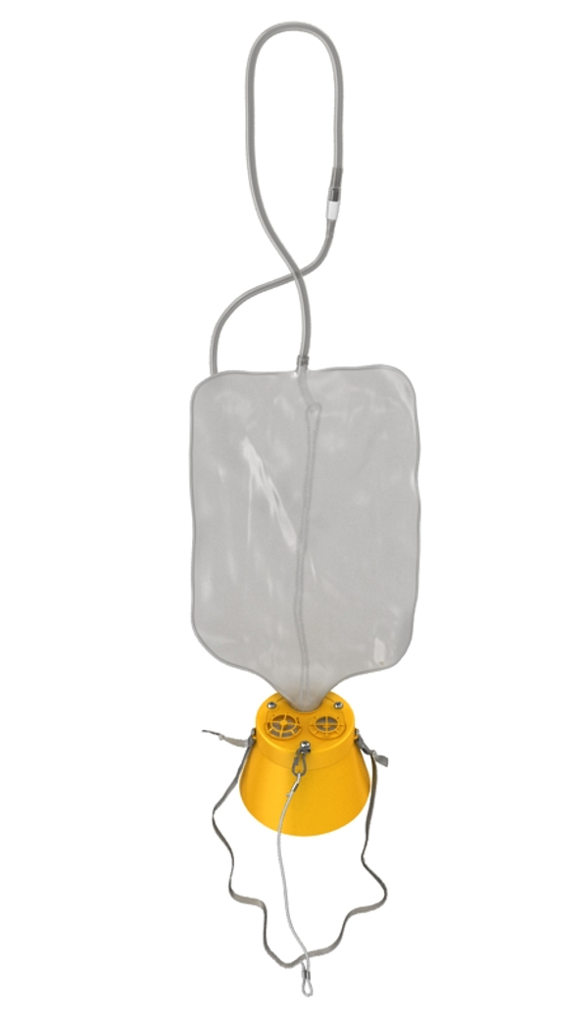
Prioritise self-care:
"Put your own oxygen mask on first, before helping others."
Notes:
Prioritising Self-Care:
Think of it like the safety instructions on an airplane: "Put your own oxygen mask on first, before helping others."
Just like in an emergency situation, you need to ensure your own wellbeing first so you can effectively support others.
Self-care is not selfish; it’s essential.
By taking care of yourself, you ensure that you have the strength, clarity, and emotional resilience to provide compassionate and effective care to others, especially in emotionally demanding roles like breaking difficult news to parents.
When you prioritise self-care, you approach your work with the energy and focus needed to be truly present for those who need you most.

Slide 36

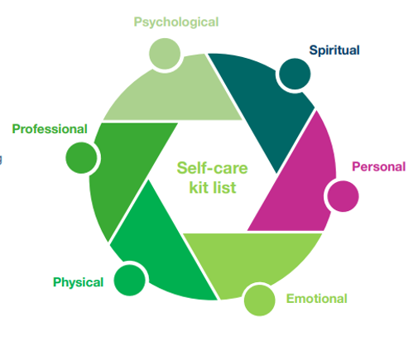

Psychological:
Reflection, debriefing, counselling, journaling
Spiritual:
Meditation, prayer, yoga
Personal:
Spend time with loved ones, read, write, cook, put time and energy into hobbies
Emotional:
Talking, crying, setting boundaries
Physical:
Exercise, being outdoors, sleeping, eating well
﻿﻿Professional:
Take holidays, ask for help, supervision
NBCP Toolkit
NBCP_Staff_Wellbeing_Resource_Toolkit.pdf (nbcpathway.org.uk)
Notes:
Introduction:
Self-care is essential for sonographers who are regularly involved in delivering difficult or uncertain news to parents during obstetric ultrasound scans. It’s about adopting practices and strategies that support your emotional and physical wellbeing, helping you manage stress, and recover from the emotional demands of your role.
Remember, taking care of yourself not only benefits you, but also the families you care for. A well-supported sonographer is better equipped to provide compassionate, empathetic care to parents during emotionally challenging situations. Self-care ensures that you can maintain high standards of care while safeguarding your own wellbeing.
Self-Care Kit List:
Psychological:
Self-Reflection: Set aside time to reflect on your emotional responses to difficult situations and ensure you process your feelings.
Debriefing: Regularly engage in debriefing with colleagues or supervisors to discuss the emotional impact of your work and share experiences.
Journaling: Keep a journal to express your thoughts and emotions, providing an outlet for self-awareness and healing.
Spiritual:
Meditation: Practice meditation to maintain emotional clarity and inner peace.
Prayer: Engage in spiritual practices that bring you comfort and support during tough moments.
Yoga: Use yoga to promote physical and mental balance, aiding recovery from stress.
Personal:
Spend Time with Loved Ones: Make time for family and friends to nurture relationships and build emotional support.
Reading: Escape with a good book to relax and recharge.
Writing: Express your emotions through writing to process your feelings and find release.
Cooking: Experiment with cooking or baking as a creative way to unwind and enjoy self-care.
Hobbies: Dedicate time to activities you love, such as painting, music, or any personal interest that helps you relax.
Emotional:
Talking: Open up to a trusted friend, colleague, or therapist to discuss the emotional impact of your work.
Crying: Allow yourself to cry when needed; it’s a healthy way to release tension and process your emotions.
Setting Boundaries: Establish clear boundaries between your professional role and personal life to maintain emotional balance.
Physical:
Exercise: Engage in regular physical activity to boost both physical and mental wellbeing.
Being Outdoors: Spend time in nature to reduce stress and reset your mind.
Sleeping: Prioritize quality sleep to support your body and mind.
Eating Well: Maintain a healthy, balanced diet to nourish your body and sustain your energy levels.
Professional:
Take Breaks: Use your scheduled breaks or leave days to relax and recharge.
Ask for Help: Seek support from colleagues or supervisors if you feel overwhelmed by the emotional demands of your role.
Supervision: Regularly access supervision sessions for guidance, support, and feedback to manage the challenges you face in your professional life.
By prioritizing self-care, sonographers can better manage the emotional weight of delivering difficult news and continue providing the compassionate care that parents need during emotionally charged moments.

Slide 37

Self-care commitment
Think of one thing that you know is good for your own wellbeing?
Make a personal commitment to yourself, for yourself.
NBCP Toolkit
NBCP_Staff_Wellbeing_Resource_Toolkit.pdf (nbcpathway.org.uk)
Notes:
Activity: Self-Care Commitment
Instructions:
Personal Reflection: Ask everyone to take a moment to reflect on one thing they know is beneficial for their self-care. This could be something simple, like taking a walk, journaling, or practicing mindfulness.
Writing the Commitment: Provide each participant with a post-it note or piece of paper. Instruct them to write down their personal self-care commitment—something they will do for themselves to prioritize their wellbeing.
Visibility Reminder: Encourage participants to place their commitment somewhere they will see it regularly, such as in their diary, on their phone, or on their fridge. This will serve as a constant reminder to honor their commitment to self-care.
Pair or Group Sharing: After the individual reflection, have participants gather in pairs or small groups. Ask them to share their self-care commitments with each other and discuss how they plan to hold themselves accountable.
Mutual Support: Encourage participants to support each other in implementing their self-care plans. They can check in with each other, offer encouragement, or share tips on how to stay on track.
Ongoing Reflection: Remind participants to implement their self-care plans in the coming days or weeks and to reflect on their experiences. Encourage them to check in with themselves and reassess their plans as needed.
Purpose: This activity helps participants take actionable steps toward prioritising self-care while creating a supportive environment for accountability and reflection. It empowers individuals to make self-care a priority and ensures they feel supported in the process.

Slide 38
Seeking Support:
Management
Peer support
Professional Supervision or Clinical Supervisor
Employee Assistance Programs (EAPs)
NHS Practitioner Health
Society of Radiographers (SoR)
Royal College of radiologists (RCR)
Trade Unions
Sands Helpline
Notes:
Seeking Support:
Management: Speak to line managers or supervisors for guidance and support in the workplace.
Peer Support: Connect with colleagues or professional networks for shared experiences and advice.
Professional Supervision or Clinical Supervisor: Access to clinical supervision for guidance on professional practice and personal well-being.
Employee Assistance Programs (EAPs): Confidential counselling and support services offered by employers for personal and professional challenges.
NHS Practitioner Health: Confidential support for NHS staff dealing with mental health or well-being challenges.
Society of Radiographers (SoR): Professional association offering resources, support, and advocacy for sonographers.
Royal College of Radiologists (RCR): Professional body providing support, resources, and training for radiologists and sonographers.
Trade Union: Support for professional issues, workplace concerns, and rights.
Sands Helpline: Support for sonographers involved in perinatal care, particularly when working with bereaved families.

Slide 39
Self care and resilience:
Supporting bereaved families presents significant challenges and may lead to compassion fatigue.
Prioritise your own mental and physical well-being to enable effective support for others.
Recognise and acknowledge your personal emotional challenges
Practice self-care and be aware of what that looks like for you
Seek support when needed
Notes:
Supporting bereaved families can be emotionally demanding and may lead to compassion fatigue.
Prioritize your own well-being: Take care of your mental and physical health to maintain the capacity to support others effectively.
Recognise your emotional challenges: Acknowledge the impact of your own feelings and responses to the work.
Practice self-care: Be aware of what self-care looks like for you and make it a priority.
Seek support when needed: Don’t hesitate to reach out for support to address emotional challenges and promote your well-being.

Slide 40
Reflection & Evaluation
Notes:
Reflection & Evaluation

Slide 41
Reflection
What is one thing you have learned today that you can put into practice tomorrow?
Notes:
Revisit the flip chart from the first session… and discuss

Slide 42
Any questions?
Notes:
Any questions?

Slide 43

Breaking Uncertain or Unexpected news:
A Practical Workshop for Sonographers
BMUS Annual Scientific Meeting: Ultrasound 2024
Please take a moment to complete the post-course evaluation form:
Access the form by scanning the QR code provided.
Your feedback is invaluable to us as we strive to constantly improve and update our training resources.
Thank you for your participation and contribution to enhancing our training programs.
Notes:
EVALUATION
Ask participants to complete the post-course evaluation form. Access by QR Code
Explain we use their feedback to constantly improve an update our training resources.

Slide 44




Thank you
Helpline Support
0808 164 3332
helpline@sands.org.uk
@SandsInsights
www.sands.org.uk/training
training@sands.org.uk
Sands (Stillbirth and Neonatal Death Society). Charity Registered in Scotland SC042789, England and Wales 299679. We also operate in Northern Ireland. Company Limited by Guarantee Number: 2212082. Registered Address: CAN Mezzanine, 49-51 East Road, London, N16AH.
Notes:
EVALUATION
Ask participants to complete the post-course evaluation form. Access by QR Code
Explain we use their feedback to constantly improve an update our training resources.

