Slide 1
Segmental Anatomy of the Liver
Clinical Relevance and Ultrasound
Gerry Johnson
Tameside Hospital, Manchester

Slide 2
Summary
Quick overview of general anatomy
Concept of functional anatomy/segments
Key anatomy to identify segments
Clinical importance of segments
Why you should integrate it into your practice

Slide 3
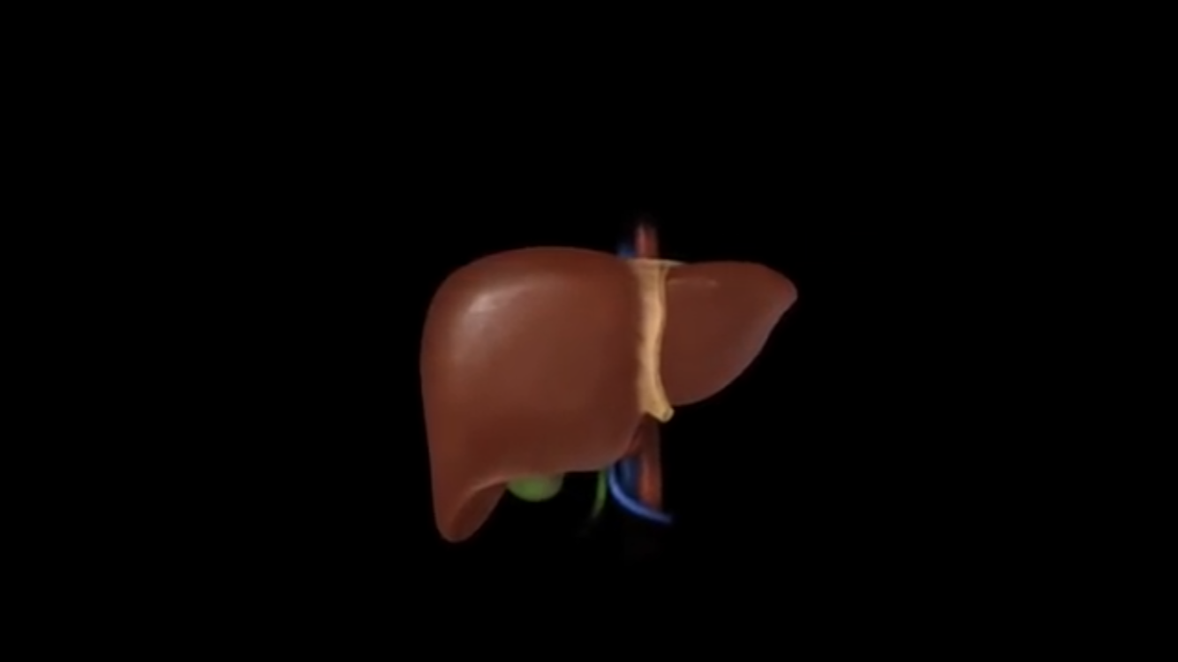
LIVER
Largest solid organ

Slide 4
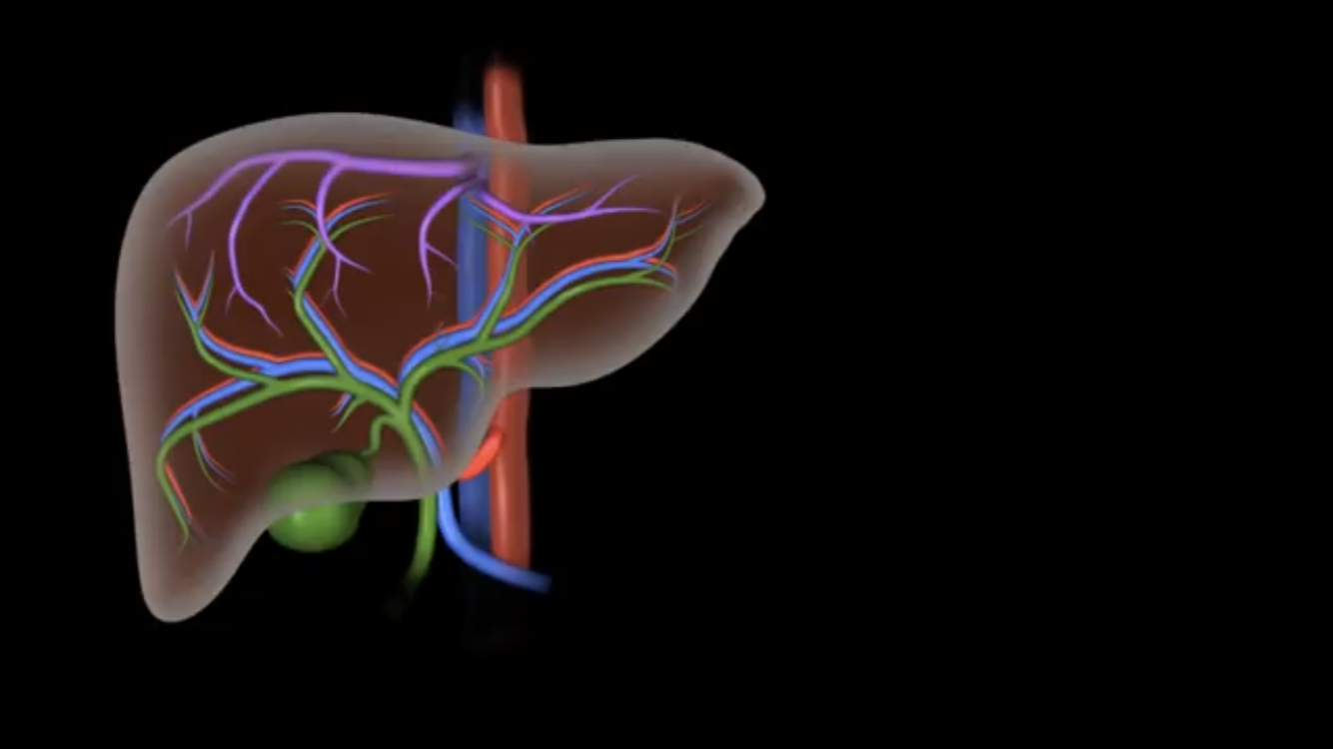
Bile Ducts
Portal Veins
Hepatic Arteries
Hepatic Veins

Slide 5
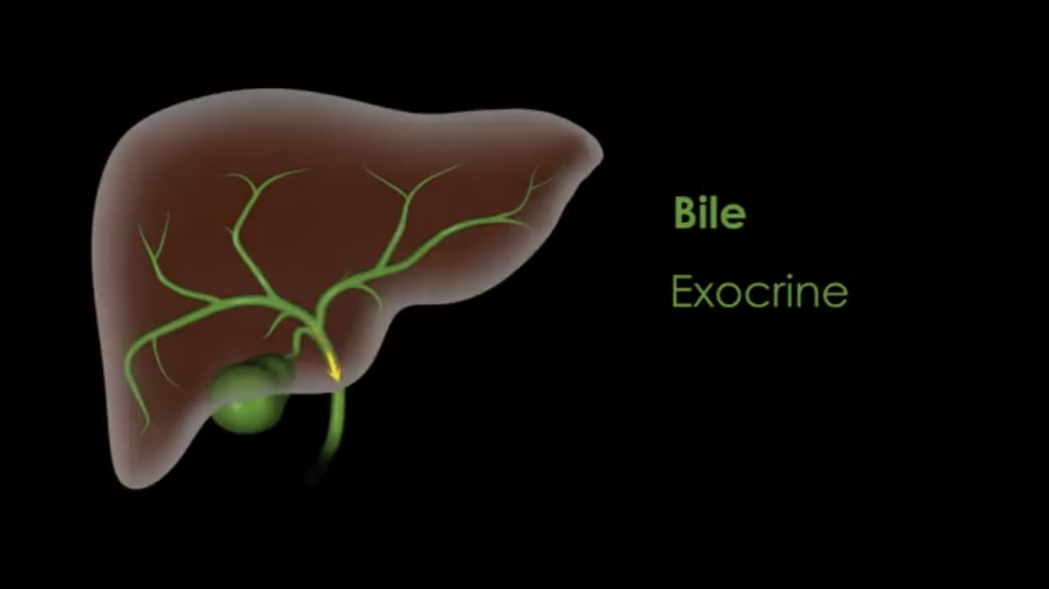
Bile Ducts
Drains bile into small bowel

Slide 6
Bile Ducts
Drains bile into small bowel to allow foods to be digested

Slide 7
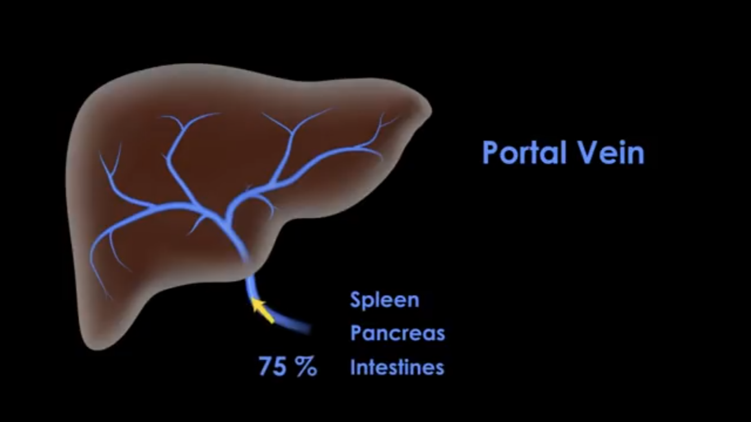

Slide 8
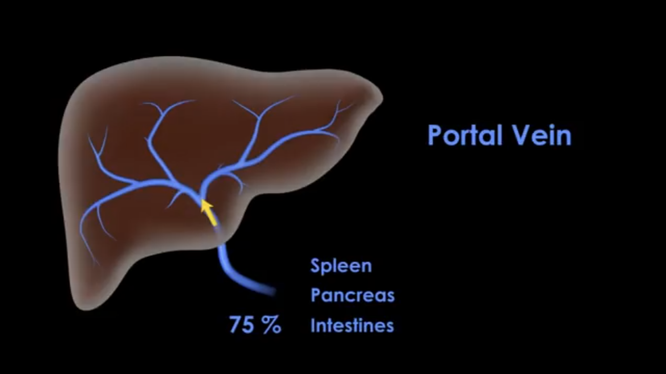

Slide 9
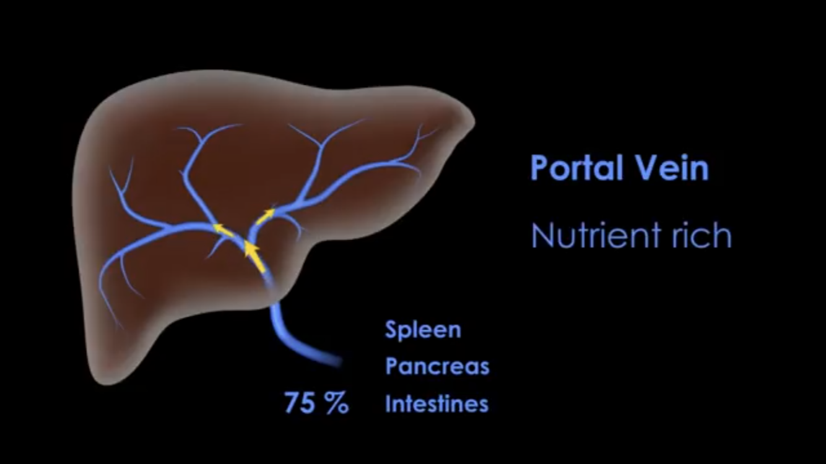

Slide 10
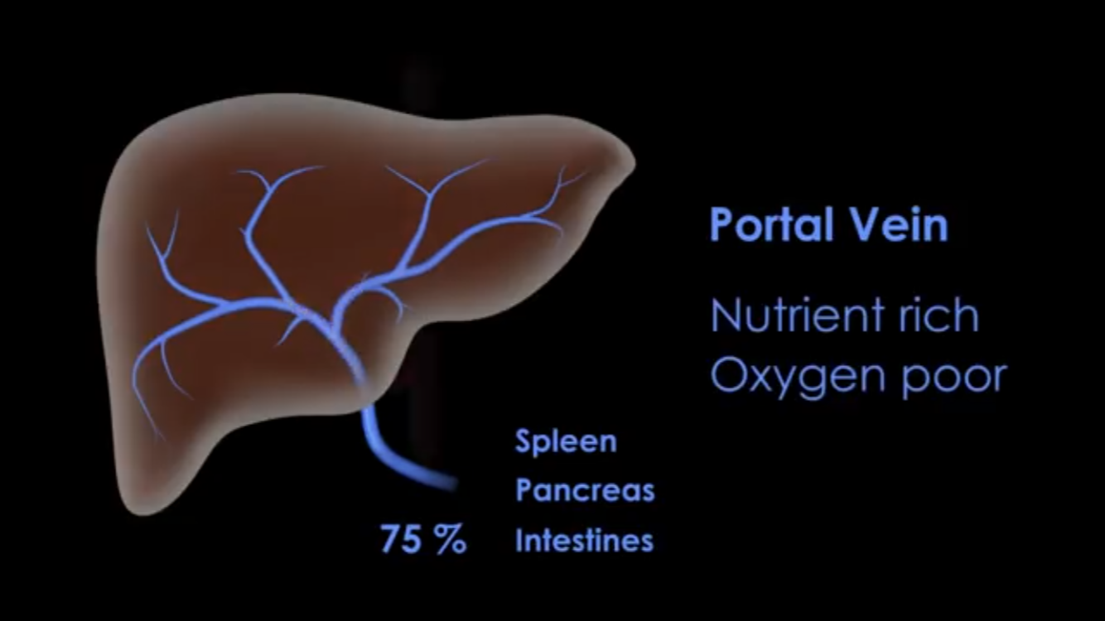

Slide 11
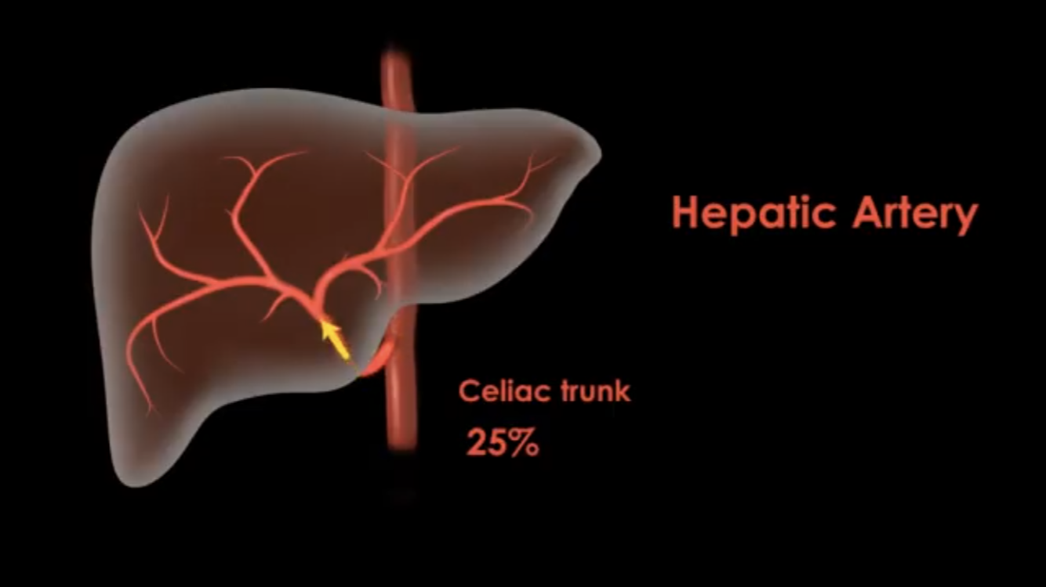

Slide 12


Slide 13
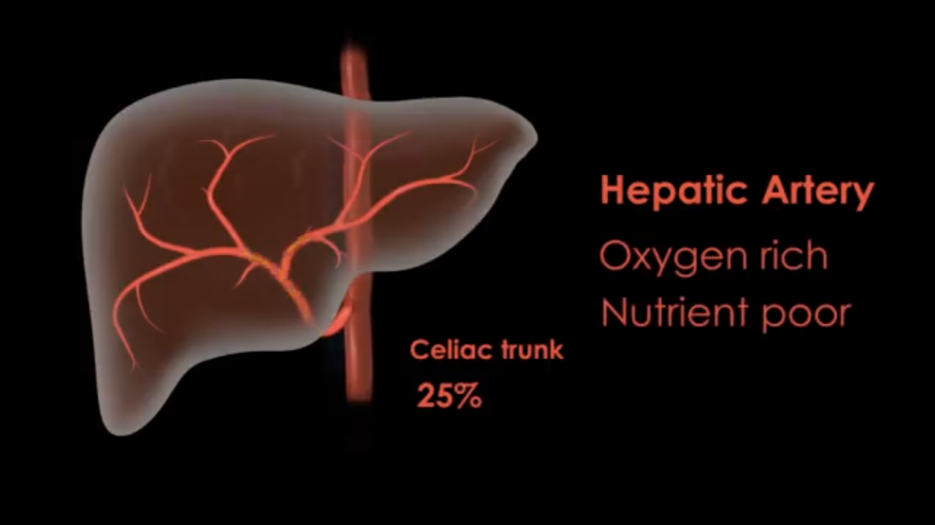

Slide 14
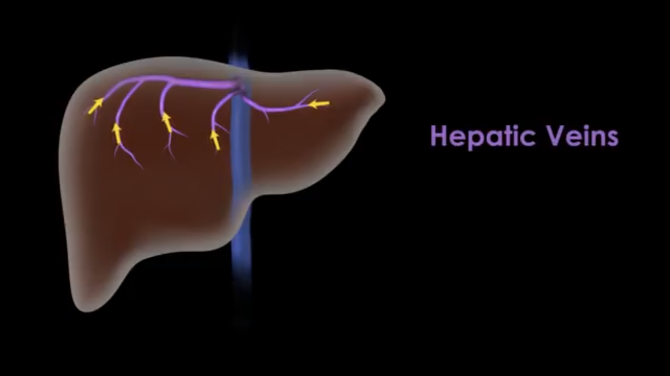

Slide 15
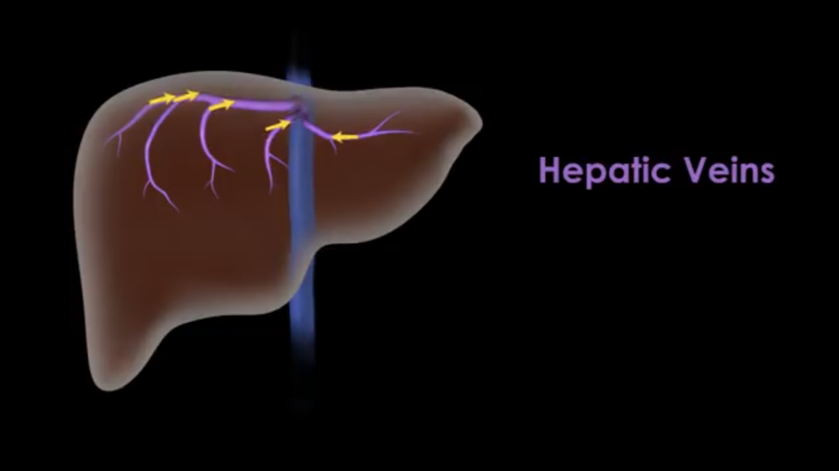
Hepatic Veins
Feed the nutrients to the circulation

Slide 16
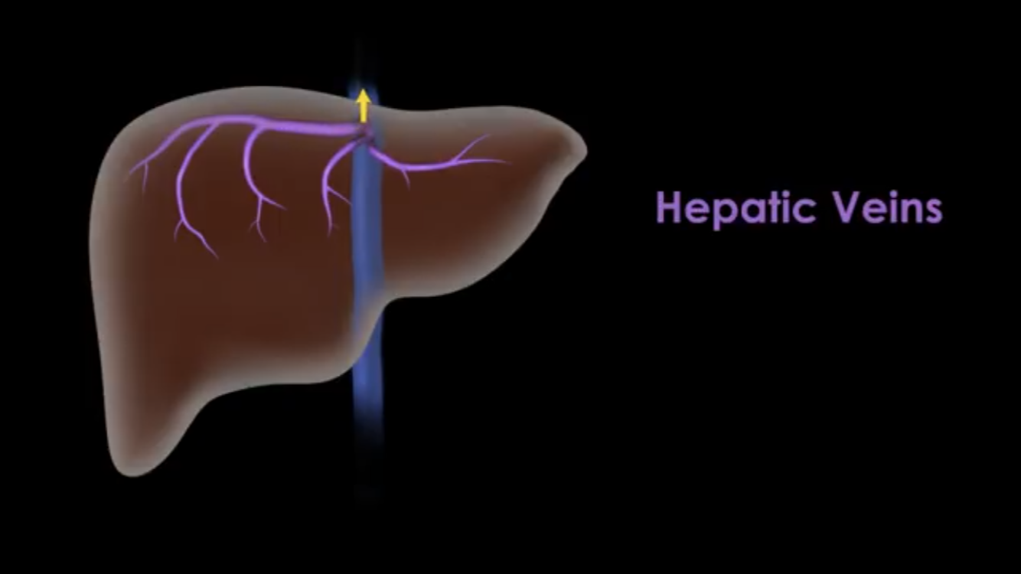
Hepatic Veins
Feed the nutrients to the circulation via IVC
Feed the nutrients to the circulation via IVC

Slide 17
Liver anatomy
Right Lobe (Visually) Right lobe - functionally
Left lobe (Visually) Left lobe - functionally
Right side Right hemiliver
Left side Left hemiliver
Right Anterior + Posterior sectors: Inf and Sup
Left Medial + Lateral sectors: Inf and Sup

Slide 18
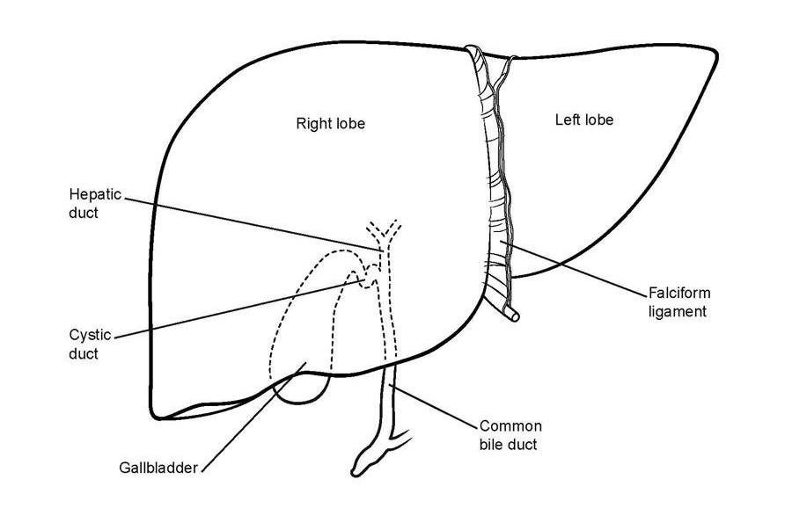
Visual Liver anatomy

Slide 19
Functional Liver Anatomy
8 sub-segments
Functional anatomical units for surgical resection
Based on hepatic artery, portal vein, bile duct (Glisson’s Triad)
Bile Ducts
Portal Veins
Hepatic Arteries
(Hepatic Veins)

Slide 20
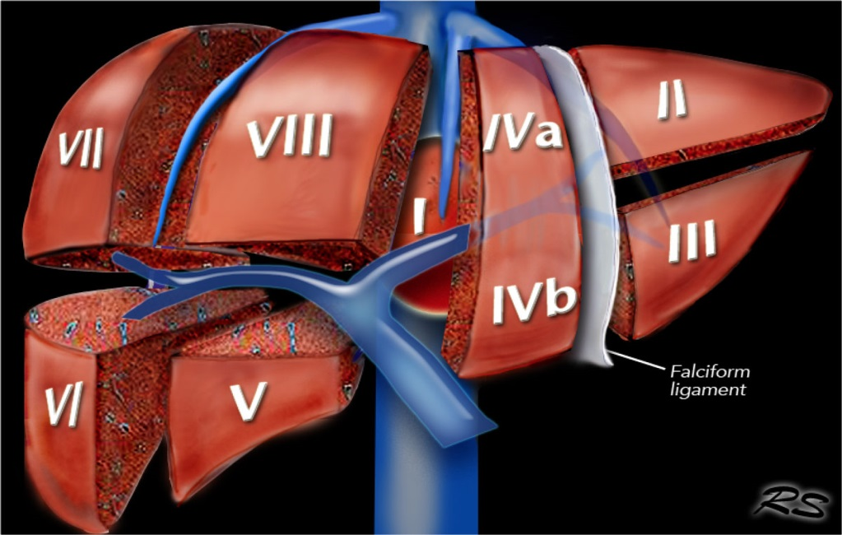
Anatomical Liver Segments
1. Caudate Lobe
2. Left posterolateral
3. Left posteromedial
4a. Left superomedial
4b. Left inferomedial
5. Right anterolateral
6. Right posteroinferior
7. Right posterosuperior
8. Right anterosuperior
Coinaud (Bismuth subdivided 4 into 4a/b)

Slide 21

7 8 4 2
6 5 4 3

Slide 22
Anatomical landmarks based around veins
Hepatic veins
Main portal Vein
Falciform (Ligamentum Teres)
GB
Intrahepatic IVC
Left portal vein (Pars Umbilcialis)
Ligamentum Venosum (Caudate)

Slide 23
1
Portal Vein
4a
2
8
7
3
4b
5
Falciform
6
Right lobe Left Lobe
Middle Hepatic Vein

Slide 24
Basic Anatomic dividers
Upper liver – hepatic veins
Mid liver – Portal vein/umbilical section of left PV
Lower liver – falciform and GB fossa

Slide 25
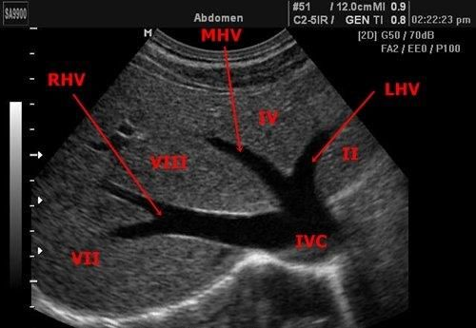
Hepatic veins
Divide the liver
Drain the liver
Intersegmental

Slide 26
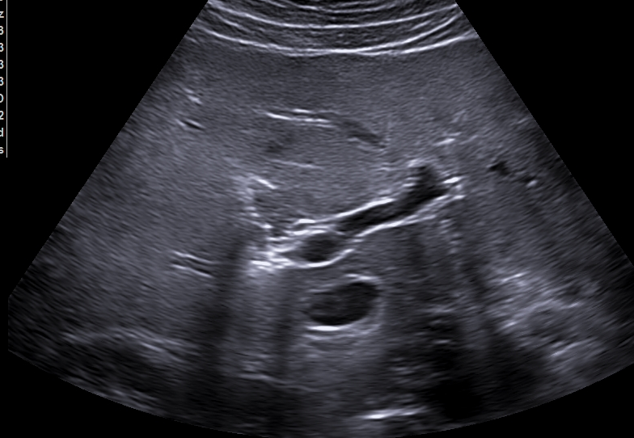
Portal Veins
Feed the segments
Names the segments
Defines the functional
Helps define the lower liver segments( 3, 4b, 5, 6)
-Main PV is used to divide SUP from INF Liver
(And to divide anterior and posterior - 5 and 6)

Slide 27


Slide 28
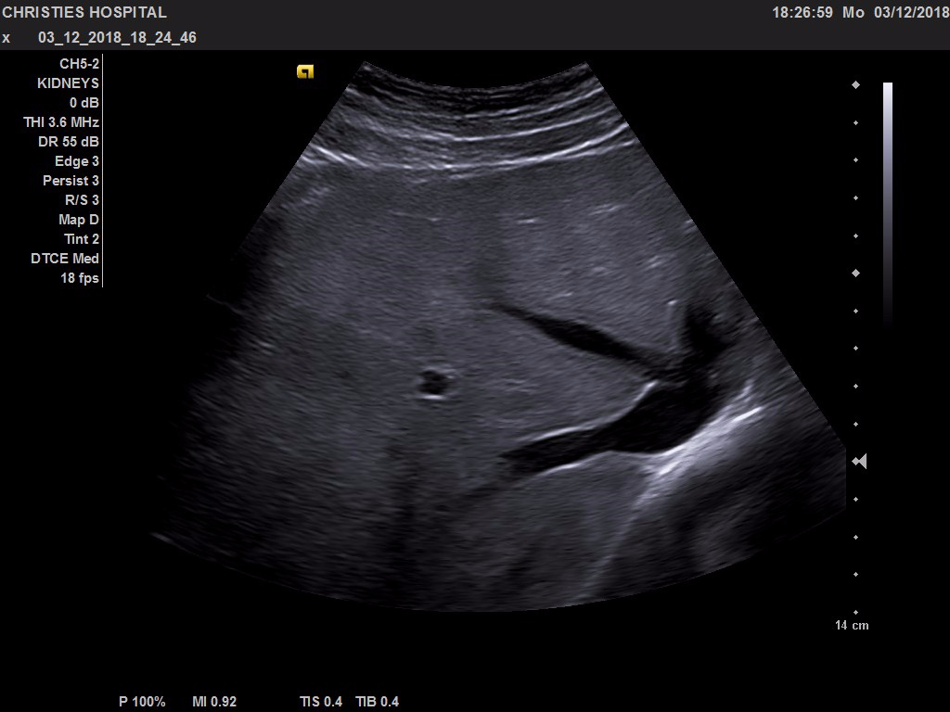
4a
2
8
1
7

Slide 29
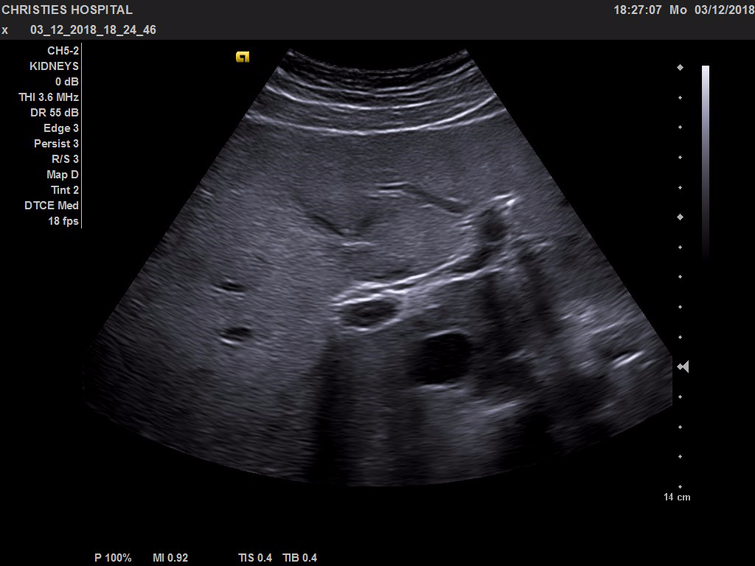
4b
3
5
1
6

Slide 30
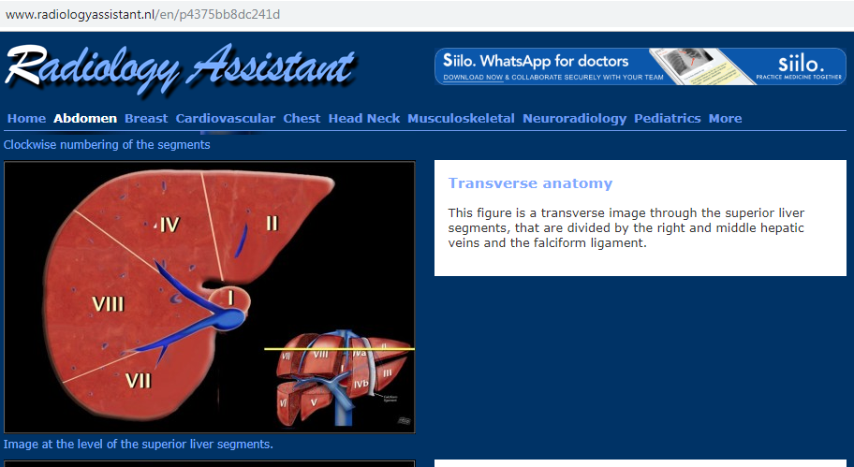
a

Slide 31
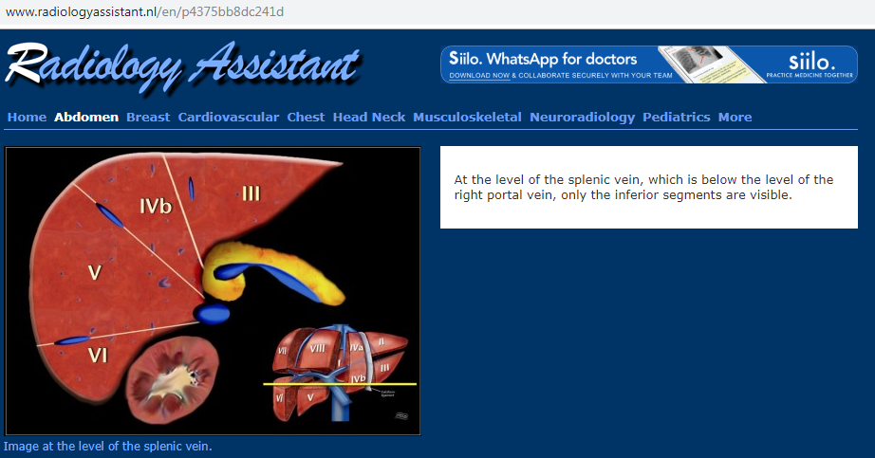

Slide 32
Summary
1
Portal Vein
4a
2
8
7
3
4b
5
Falciform
6
Right lobe Left Lobe
Middle Hepatic Vein

Slide 33
Summary
Segmental anatomy vital for surgery
Will always have MRI prior to surgery
Important for standardisation
Opportunity to prevent/avoid CT errors
Important for Biliary intervention

