Slide 1

Diagnostic Error – 2nd Victim Obstetric Sonographers: experiences of impact and support
Elaine Gardiner, Programme Lead MSc Medical Ultrasound, Professional Doctorate Candidate
Supervisors: Dr Julie Roberts & Dr Evelyn McElhinney

Slide 2

How many have heard the term:
Diagnostic Error?

Slide 3
Diagnostic Error
“A diagnosis that is missed, wrong or delayed, as detected by some subsequent definitive test or finding”
Lee et al (2013)
Notes:
This definition by Lee et al, states that a diagnostic error is a diagnosis that is missed, wrong or delayed, as detected by some subsequent definitive test or finding.

Slide 4
Diagnostic Error in Obstetric Ultrasound
Performing obstetric sonography can potentially bring serious medico-legal risks
Most errors due to failure to diagnose an abnormality
Multifactorial contributors:
  Systemic Factors
  Cognitive Factors
Notes:
When considering obstetric ultrasound, errors in antenatal care can have devastating consequences for the child and family and this includes errors in antenatal ultrasound diagnosis (NHS Resolution, 2019).
Ultrasound plays a critical role in the diagnosis of many conditions, but because of the subjective nature of interpretation of ultrasound findings it is more prone to errors than other imaging modalities.
There is a real risk that Sonographers working in obstetric practice, will make a diagnostic error which results in missing a significant pathology or abnormality during their ultrasound career.
Many authors acknowledge that there are multifactorial contributors to making a diagnostic error, but fundamentally these are attributed to a combination of systemic and cognitive factors.

Slide 5
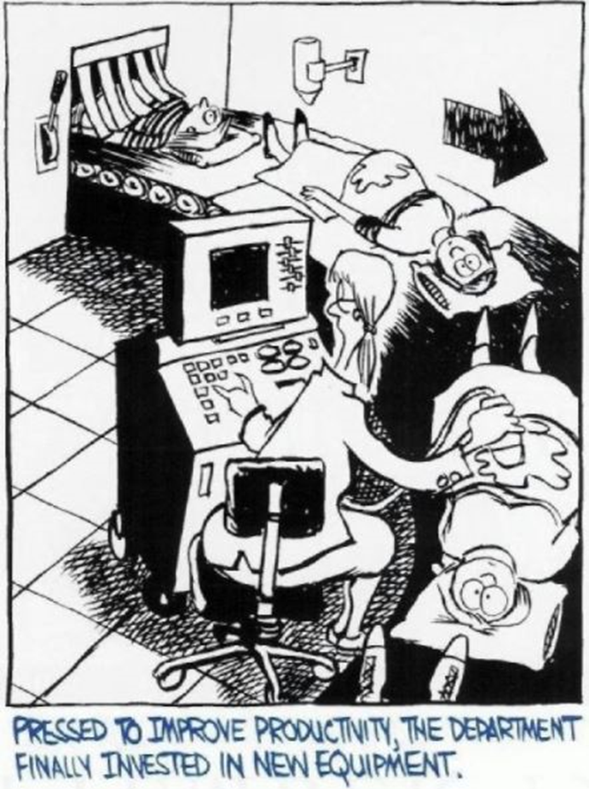
Diagnostic Error – Systematic Factors
Inefficient processes
Knowledge and skills
Time constraints
Resource shortages
Task receptiveness
Fatigue
Stress
Lighting
Patient body habitus
Fetal position
Equipment failures
Training
Notes:
In addition to sonographer training and skills, system-related factors which contribute to diagnostic error are those which impact the sonographers psychophysical processes of visual diagnosis, such as lighting conditions, length of shift, timing and pace of workload, staffing and repetitiveness of the task. All reportedly contributing to both visual and mental fatigue. (Sotiriadis and Odibo, 2019)
Additional factors in obstetric ultrasound include increased patients body habitus and sub-optimal fetal position.

Slide 6

Diagnostic Errors – Cognitive Errors
Errors caused by how we think – due to several failures:
Failures in:
  Perception
  Heuristics
  Biases
Notes:
Sonographer training has traditionally focused on learning core technical psychomotor skills required to perform an ultrasound scan, such as pattern recognition, hand-eye coordination and transducer dexterity. Less attention was paid to developing clinical decision making skills.
How we think, reason and make clinical decisions and judgements is essential in forming a correct diagnosis (Croskerry, 2013 and Thoirs and Sim, 2016).
Cognitive errors can be a driving factor in making diagnostic errors with failures in perception, heuristics and cognitive biases all contributing (Itri and Patel, 2018).

Slide 7

Failures in Perception
Common where active observation is a key part of professional activity
Failure to detect an anomaly visible on scan due to psychophysiological factors of human visual perception
  Levels of alertness
  Fatigue
  Duration of the scan
  Conspicuity of the abnormality
  Distracting factors
Notes:
A failure in perception in ultrasound, also known as a perceptual error, can occur when a sonographer misses an anomaly that is visible on the scan. This is common where active observation is a key part of job.
Levels of alertness, fatigue duration of the scan and how obvious the abnormality is can all contribute to a miss-diagnosis. (Itri and Patel, 2018)
And the unique situation in obstetric ultrasound where patients arrive for their examination with their entire family can most definitely cause distractions!

Slide 8

Heuristics
An approach to problem solving
Strategies derived from previous experiences with similar problems
Mental shortcuts
Allow us to problem solve / make judgements quickly
Ignoring some information - focusing on relevant predictors
Notes:
Another factor to consider are Heuristics.
Heuristics are mental short-cuts that streamline information and allow rapid problem solving based on assumptions and past experiences. We use these short-cuts in our clinical decision making by ignoring part of the available information and basing decisions on only a few relevant predictors. (Itri and Patel, 2018)
So although they allow for faster processing of information, they can also lead to errors because not all information is considered.

Slide 9
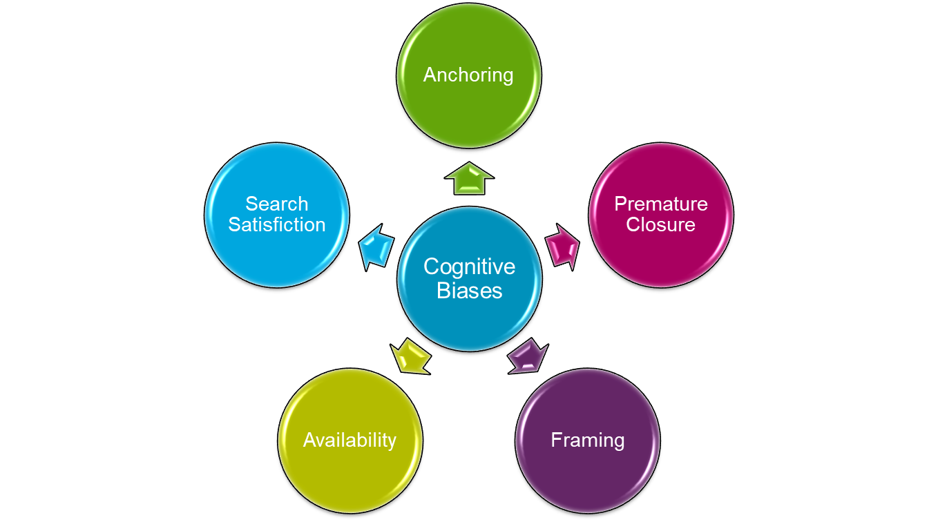
Cognitive Bias
Systematic errors in judgement that predispose one’s thinking
Notes:
There are several common cognitive biases that result from failed heuristics, that are relevant to us as Sonographers:
Anchoring - relies on initial impression and fails to adjust this impression with subsequent information – detection of major abnormality at beginning of scan and superficial examination of rest of fetus
Premature closure - tendency to accept a diagnosis without considering other possible diagnoses or collecting all relevant data
Framing - strongly influenced by how a question is asked or a problem presented- common when fetus is referred to assess a particular condition
Availability Bias - tendency to consider diagnosis more likely if it readily comes to mind – influenced by the ease of recalled experiences such recalling a similar case presented in recent seminar
Search Satisfaction - tendency to stop visual searching for additional abnormalities once an initial abnormality has been found – for example in early pregnancy satisfaction with detection of fetal pole in utero and failure to diagnose heterectopic pregnancy.
Chen, Gandomkar and Reed, (2023) and Sotiriadis and Odibo (2019)

Slide 10
My Professional Doctorate . . .

Slide 11
Rationale for the Study
A “missed” or undiagnosed fetal abnormality can have devastating consequences for the child and family
Despite targeted training 20 – 67% of congenital heart disease (CHD) remain undetected antenatally (NCHDA 2023)
Real risk that Sonographers will make a diagnostic error resulting in missing a significant pathology or abnormality
The impact that diagnostic errors have on Obstetric Sonographers health and well-being is poorly understood or appreciated
Support offered to Sonographers following making a diagnostic error also appears to be limited
Notes:
In the delivery of healthcare, it is expected that healthcare professionals will provide excellent care and hence they are not expected to make errors. However, healthcare is not a perfect science and human involvement is innately linked with some degree of error.
From my experiences as both an obstetric sonographer and Ultrasound manager, I knew that errors in antenatal ultrasound care can have devastating consequences for the child and family. I also knew that despite targeted and enhanced training, congenital heart disease (CHD) remains one of the most commonly “missed” or undiagnosed abnormalities at the 20 week fetal anomaly screening scan with regional variations but between 20 – 67% undetected antenatally. CHD is associated with significant morbidity and mortality and is reported to be the primary cause of infant death (Carvalho et al, 2013).
There is a real risk that Sonographers working in obstetric practice, will make a diagnostic error which results in missing a significant pathology or abnormality during their ultrasound career.
I also knew that the impact that diagnostic errors have on the Sonography workforce’s health and well-being is poorly understood or appreciated. Additionally, the support offered to Sonographers following a diagnostic error appears to be limited and I felt required further investigation.

Slide 12
Aim and Study Design
Aim:
Mixed Methods Design:
1st Stage – Second Victim Experience and Support Survey (SVEST)
2nd Stage – Semi-structured Interviews
Reflexive Thematic Analysis / Themes
Reflexivity
NHS Sonographers who have made a diagnostic error
To explore the views, experiences and impact on “second victim” NHS Obstetric Sonographers following making a diagnostic error
Notes:
This study aims to explore the views, experiences and impact on “second victim” Obstetric Sonographers following making a diagnostic error.
Methods:
A mixed methods design was adopted with a quantitative 1st stage, whereby NHS sonographers who had made a diagnostic error were invited to complete an online survey. We used a second victim experience and support survey or SVEST tool which had previously been deployed and validated in exploring second victim syndrome in both nurses and radiology staff in several countries and healthcare settings.
This then informed and guided the 2nd stage semi structured interviews which contextualised and enriched findings of the first stage. Reflexive thematic analysis was adopted and Nvivo and Excel used to allow coding, themes and subthemes.
As reflexivity is also an important component of hermeneutic phenomenology and critical self-evaluation was undertaken via a reflective journal.

Slide 13
How many have heard the term:
Second Victim?
Notes:
When an adverse medical error occurs, both the patient and healthcare professional are affected. The patient is clearly the first victim; however the healthcare professional is often referred to as the second victim.

Slide 14
"Second Victim" Phenomena
“A health care provider involved in an unanticipated adverse patient event, medical error, and/or a patient related-injury who became victimized in the sense that the provider is traumatised by the event. Frequently second victims feel personally responsible for the unexpected patient outcomes and feel as though they have failed their patient, second guessing their clinical skills and knowledge base” ​
(Scott et al, 2009. pp. 326)
Notes:
In exploring the literature relating to diagnostic or medical error – the term second victim or second victim phenomena kept re-occurring.
The term second victim was first defined by Scott et al, in describing the profound and long-lasting impact that medical errors can have on health care professionals who felt responsible for an adverse outcome.
This was new a new term to me, but felt like an almost light-bulb moment in my research journey

Slide 15


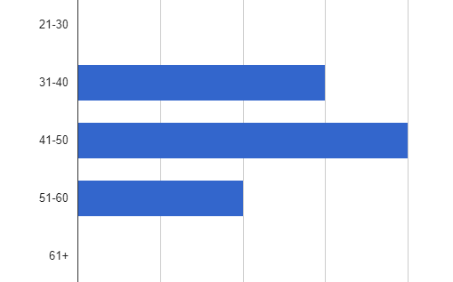
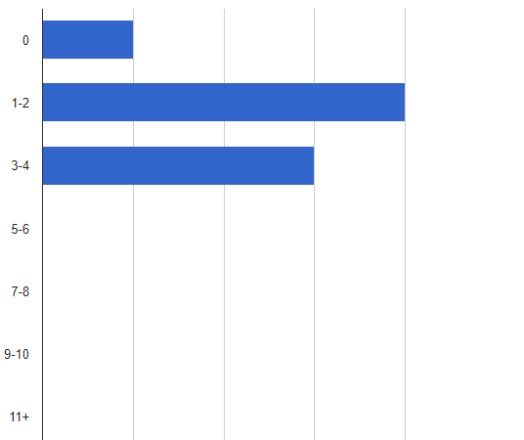
Participant Characteristics (n=8)
Age
Professional background
  50% Radiography
  50% Midwifery
Level of education
  87.5% Master's Degree
  12.5% Postgraduate Diploma
Years practicing in Obstetric Ultrasound
  Range: 0 – 5 to 26+
  Mode: 6 – 10yrs
No of scan sessions per week
  Range: 0 – 11+
  Mean: 5 - 6
No of training sessions per week
Notes:
8 participants, all female, ranging between 31 – 60 years old.
50% Radiographers, 50% Midwives, most were educated to Master’s level and one to PgD.
The length of time people had been scanning ranged from 0 – 5 years to more than 26 years (average 6 – 10years).
The number of scan sessions per week ranged from 0 – 11+, average 5 -6
Most also took part in delivering training sessions each week.

Slide 16

Key Themes
Personal and Professional Impact
Levels of Support
Individual Needs
Sonographer role and Environment
Learning about the Error
Notes:
Integrated results of the quantitative and qualitative phases identified five core themes: Sonographer role and environment, learning about the error, personal and professional impact, levels of support and Individual needs

Slide 17

Sonographer Role
"I think it's such a unique job . . . there is no other no other job that you see on the hoof, and you have to explain to that person on the bed that what you’ve found is gonna rock their world"
"when they come in to us they don't have that warning shot. . . so we get it all. . . . the anger . . . denial . . . their whys . . . and they're upset and then you have to put them into a quiet room, get them a cup of tea and go into the next couple and be all smiles . . . it's like Jackal and Hyde, you're 2 personalities that you're trying to be very appropriate for all people, whatever situation that they're in"
Notes:
Most obstetric sonographers considered their role to be unique and that both patients and healthcare professionals poorly understood this role. They described the practical and emotional challenges in carrying out the scan and the pressure of giving the findings or results immediately to patients, especially when these findings are unexpected or distressing. “explaining that what you’ve found is gonna rock their world”
Half of the sonographers also described the personal impact of delivering an appropriate emotional response for each patient and scan outcome. Delivering unexpected or sad news one minute and good news the next, repeatedly throughout the day caused a shift in their emotional identity. One sonographer described it as being like Jackal and Hyde – trying to be appropriate for all people whatever the situation.

Slide 18
Working Environment
"when I started scanning the philosophy of defensive scanning was very prevalent. . . I still see it now. . . “don’t wear a name badge because if they don't know who you are, they can't report you”
Self-preservation techniques
Blame Culture
Workload Pressures
Burnout / Fatigue
"fear of a backlash on social media"
"I suppose for sonographers I think that everybody is just exhausted . . .they're burnt out. We did the pandemic.. . . everybody is tired"
"when staffing is an issue I feel that's where incidents can occur . . . due to fatigue"
Notes:
Half of the Sonographers described the culture of their departments in negative terms. Two sonographers describe self-preservation techniques in an attempt to protect themselves from criticism or harm. One discussed a defensive mind-set where they were encouraged not to wear name badges. While another tells how they and their colleagues refused to allow their pictures to be displayed on staff picture boards for fear of repercussions or being identified by name and criticised on social media.
All Sonographers reported working in high-pressurised busy departments and several reported that fatigue and burnout were factors, despite adhering to the scan timings as recommended by the British Medical Ultrasound Society (BMUS). One sonographer linked fatigue to the Covid-19 pandemic and another suggested that staffing levels and fatigue could contribute to errors being made.

Slide 19
Learning about the Error
When that consultant said “Can I have a word with you?”. . . automatically your heart just sinks
Manager / Consultant
Wider Knowledge of the Error
Carrying on with the scan list
"the ripples just go through the whole department. . . . if your colleague just found out . . . the rest of you know within a heartbeat"
"you're just devastated . . . you don't have that immediate time to process . . .and you're just holding it all in and then feeling teary at the same time. . .
and then you wonder if you're actually missing things again because you’re not completely focused cause you keep thinking again to that news"
Notes:
In most circumstances the news about having made an error was broken by their line manager or Consultant, but in one case by the legal team acting for the sonographer’s hospital. They describe how their heart just sinks when called by the consultant to have a word.
Additionally, there was a lack of discretion and some sonographers felt news just rippled through the department. They were almost the last to know, everyone in the department knew that they had made an error before they knew themselves
There also appeared to be a common theme of the Sonographer being told that they had made an error or missed an abnormality and then being expected to immediately carry on with the rest of their scan list, despite feeling upset or distracted

Slide 20
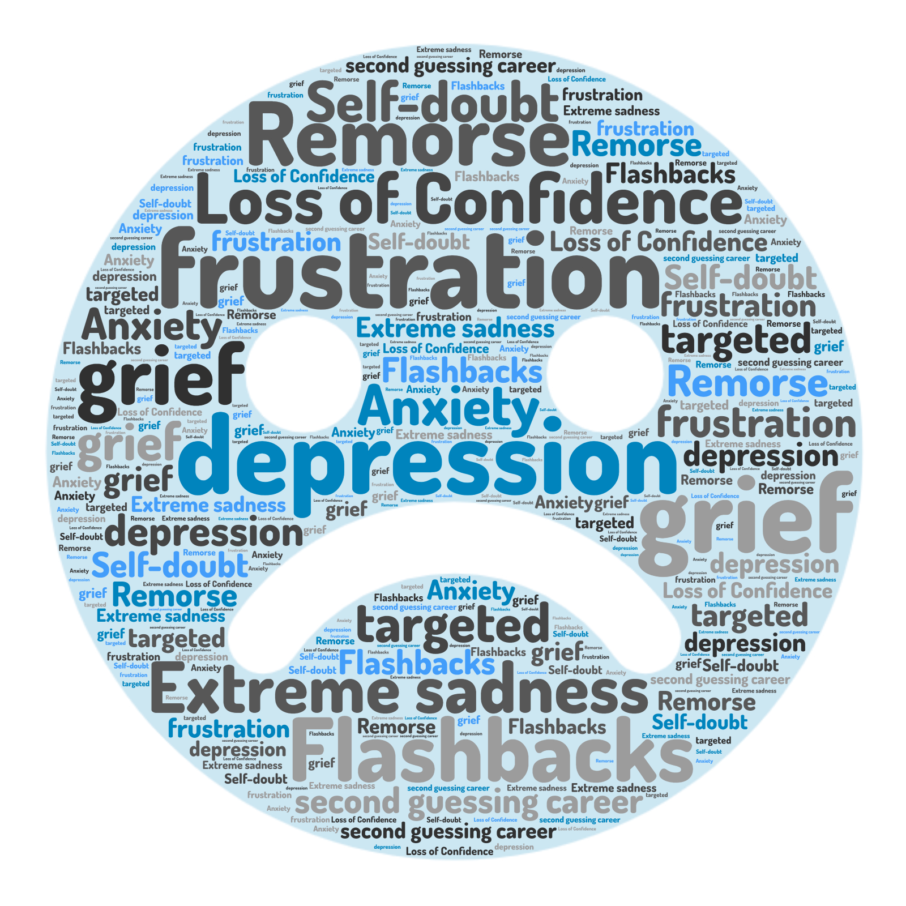
Personal Impact
"I felt I was grieving. I felt like it was the six stages of grief . . . and it wasn't even my own baby"
Notes:
Personal Impact
This word cloud highlights some of the language used during the interviews – when asked to describe psychosocial symptoms following a diagnostic error.
Frustration, depression, remorse, loss of confidence were common to pick out a few.
Almost all felt deep remorse or guilt at their involvement in making diagnostic error – most were embarrassed and fearful of it happening again.
During the interviews many also suggested that because their error impacted a child, this compounded their grief.
“ I felt like I was grieving. I felt like it was the six stages of grief – and it wasn’t even my baby!”
Several Sonographers, were able to instantly recall dates of birth and names of the children involved.

Slide 21

Professional Impact
"And it changed my practice. I became, if anything, slightly more paranoid. I stopped scanning not long after that because I couldn't continue. I started getting chest pains and pins and needles"
100% experienced feelings of inadequacy
70% afraid to attempt difficult / certain scans
72% negatively affected their performance at work
87% grown as a professional as a result / greater resilience
100% led to a desire to take a position outside of healthcare
Notes:
Professional Impact
All felt inadequate in delivering patient care and many became afraid to attempt certain scans.
Similar numbers indicated that their performance at work was negatively affected, however most felt they had grown as a professional and developed greater resilience.
All reported that they had wanted to take up another position – and one interviewee stated that “it changed my practice. I became, if anything slightly more paranoid. I stopped scanning not long after that because I couldn’t continue, I started getting chest pains and pins and needles.

Slide 22
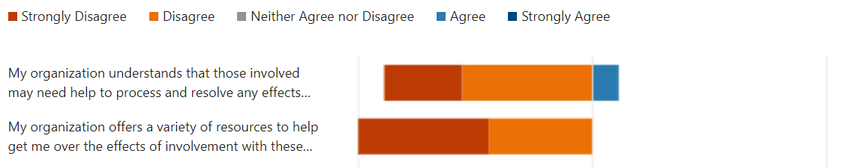
Support
Colleague Support
"I did have my colleagues and one of my colleagues was very supportive"​
​
"we all ended up having a situation where we were involved in a miss-diagnosis. . . we had to chat amongst ourselves in order to get a little bit of . . . I suppose comfort . . . you know a bit of support"​
“I think that one person I talked to the most just knew ‘ cause they’d been in similar situations, so they understood how you felt, the guilt, all the feelings that you had ‘cause they’d been there before”
Organisation Support
Notes:
Looking at Colleague v Organisational Support
Following an error, colleagues were found to be most supportive. “Sonographers would chat amongst themselves to get a little bit of comfort – because they understood how you felt”
While organisational support was reported as poor, with a lack of understanding and lack of concern for their well-being high factors. One sonographer felt alienated by higher management.

Slide 23
Support
Manager Support
"Very casual . . . looking back, He didn't let any of this stuff ever hit any of the sonographers . . . he'd just drop it into conversation and say it's fine. Don't worry about it. Hasn't changed the outcome. Absolutely fine. It's dealt with. Don't worry about it. . . . . . and that's how he was with everyone with errors. ​
Which on the one hand is great, but it misses opportunities for learning and it misses opportunities for identifying weak points . . . making sure that you learn from them. ​
It is . . . it's a missed opportunity for professional development, for safety."
Notes:
Manager Support
Manager support appeared variable with one sonographer reporting that their manager’s attitude was very laid back
"Very casual . . . He didn't let any of this stuff ever hit any of the sonographers . . . It's dealt with. Don't worry about it. . . .”
However on reflection this sonographer highlighted that this approach was a missed opportunity for learning . . . a missed opportunity for patient safety"

Slide 24

Individual Needs / Desire for Change
Change in department culture
Part of the MDT case reviews / having a voice
Change how they learn about the error
A peaceful location to recover and re-compose
Discussion with line manager or supervisor
Ability to talk to a respected peer
Access to a Counseller / Employee Assistance Program
Notes:
All sonographers indicated that they wanted change in the way they learned about the error and the support offered.
Most wanted a change in culture, where errors could be talked about and learned from and that they had a voice and were involved in MDT case reviews.
After learning about the error, most Sonographers wanted a peaceful location away from the department and time to recompose, rather than just carrying on with their list when they were teary and couldn’t concentrate.
There was also a strong desire to be able to talk about what had happened with a respected peer (i.e. not their line manager, but rather someone similar to a supervisor of midwives, but for ultrasound.
Some also indicated the desire for greater organisational support with access to counselling services.

Slide 25
Key Findings
Only one Sonographer had heard of 2nd victim phenomena – all experienced it
Obstetric Sonographers experience both psychological and physical distress following an adverse incident/ error
Level of Support:
  Colleagues most supportive
  Managers variable support
  Organisations poor / limited
Professional self-efficacy is negatively impacted, but 2nd victims had greater resilience
All displayed an increased desire to seek other posts
Desire for change:
  Department culture
  To have a voice - to be included MDT reviewing cases
Most favoured support mechanisms include:
  A person-centred approach
  A peaceful location to recover and recompose
  A respected peer to discuss the details of what happened
  Access to counselling support
Notes:
Key Findings:
All Sonographers had experience of 2nd victim phenomena, despite only one having heard of it.
Its clear Sonographers experience both psychological and physical distress following an error and for some this is long-standing.
Levels of support is variable, with colleagues most supportive
All sonographers had considered seeking other posts and felt “unheard” wished a voice in the department.
The most favoured support mechanisms include a person centred approach, time to recover, recompose. And the desire to talk with a respected peer and counsellor was strongly desired.

Slide 26

Next Steps . . .
Complete write-up
Submission of thesis & Viva
Disseminate findings
Recommendations for NHS practice and policy
Notes:
Next Steps
The next steps for me include completing write up and submission of my thesis, the Viva and the ongoing dissemination of my findings.
I hope that my study will raise awareness of second victim phenomena and its impact on Sonographer health and well-being. With a view to making recommendations to NHS practice and policy relating to best practice support mechanisms.

Slide 27
Thank you
Any Questions?

Slide 28
References
BURLISON, J.D., QUILLIVAN, R.M.S., SCOTT, S.D., JOHNSON, S. and HOFFMAN, J.M., 2018. The effects of the second victim phenomenon on work-related outcomes: connecting self-reported caregiver distress to turnover intensions and absenteeism. Journal of Patient Safety. Available at DOI: 10.1109/EMBC.2016.7590696.
NHS Resolution. 2019. Annual report and accounts 2018/19. available at www.gov.uk/official-documents
NYDOO, P., PILLAY, B.J., NAICKER, T. & MOODLEY, J., 2019. The second victim phenomenon in health care: A literature review. Scandinavian Journal of Public Health. , pp.140349481985550-1403494819855506. Available from: 10.1177/1403494819855506
SINGH, N., KNIGHT, K., WRIGHT, C., BAIRD, M., AKROYD, D., ADAMS, R.D. and SCHNEIDER, M.E., 2016. Occupational burnout among radiographers, sonographers and radiologists in Australia and New Zealand: Findings from a National survey. Journal of Medical Imaging and Radiation Oncology. 61(3), pp. 304-310.
SOTIRIADIS, A. and Odibo, AO. 2019. Systematic Error and cognitive bias in obstetric ultrasound. Ultrasound in Obstetrics and Gynaecology. 53. Pp431-435
NATIONAL CONGENTAL HEART DISEASE (NCHDA) 2023 Summary Report. Available at https://www.nicor.org.uk/wp-content/uploads/2023/06/10633-NICOR-Annual-Summary_Reports_NCHDA_domain_Report_v7.pdf
LEES, CS, NAGY, PG, WEAVER, SJ and NEWMAN-TOKER DE, (2013), Cognitive and System Factors contributing to Diagnostic Errors in Radiology. Medical Physics and Informatics, AJR; 201: 611-617
CARVALHO J.S, ALLAN L.D, CHAOUI R, COPEL J.A, DEVORE G.R, HECHER K, LEE W, MUNOZ H, PALADINI D, TUTSCHEK B and YAGEL S. (2013) ISUOG practice guidelines (updated): sonographic screening examination of the fetal heart. Ultrasound Obstetrics and Gynecology Vol. 41. pp. 348–359
COSKERRY, P (2009), A Universal Model of Diagnostic Reasoning. Academic Medicine, Vol 84, (8) p1022-1028
CHEN, J, GANDOMKAR, Z and REED, W.R. (2023) Investigating the impact of cognitive biases in radiologists’ image interpretation: a scoping review. European Journal of Radiology, Vol. 166. 111013
ITRI, J.N and PATEL, S.H. (2018), Heuristics and Cognitive Error in Medical Imaging. American Journal of Roentgenology. Vol 210 (5) pp. 937-1177.
SCOTT, S D.,L E HIRSCHINGER, K R COX, M MCCOIG, J BRANDT, L W HALL. 2009. The natural history of recovery for the healthcare provider “second victim” after adverse patient events. Quality and Safety in Health Care. 18: pp325-330.
WU AW. (2000) Medical error: the second victim. Often the doctor who makes the mistake needs help too. BMJ. pp.320:726–727.
THOIRS, K and SIM, J. 2016. Using a clinical decision making framework to foster sonographer student learning in the clinical setting. Sonography 3. Pp146-153

