Slide 1


PoCUS Research-Quantity over Quality?
Kalyana Murali FRCEM DMU
Deputy Editor, Ultrasound
Consultant in Emergency Medicine, Queen Elizabeth Hospital, Birmingham

Slide 2

1794!
Bats used sound
to navigate [Echolocation]

Slide 3
19th Century
Jean Colladon 1826 [Swiss Physicist]
Christian Doppler 1842 [Austrian Mathematician/Physicist]
Sound travelled faster under water[ 1435m/s] than in air
Presented “On the coloured light of the double stars and certain other stars of the heavens” [Royal Bohemian Society of Science (May 25, 1842) ]

Slide 4

19th giving way to the 20th Century
Piezoelectricity
Jacques & Pierre Curie
Société
minéralogique
de France 1880
First Transducer
Paul Langevin & associates
following a series of research/prototypes
1915-20

Slide 5


1942
"On the possibility of using high frequency mechanical vibrations as a diagnostic tool"
Karl Dussik, Psychiatrist/Neurologist

Slide 6
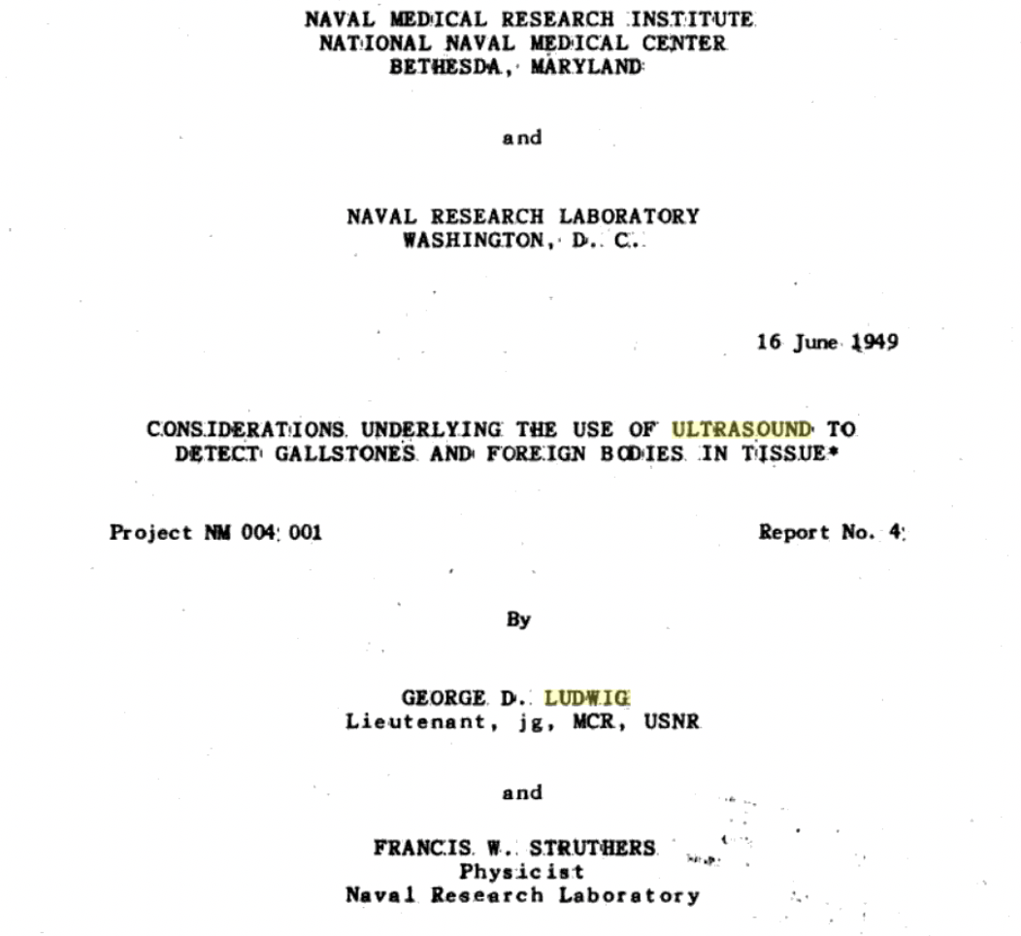
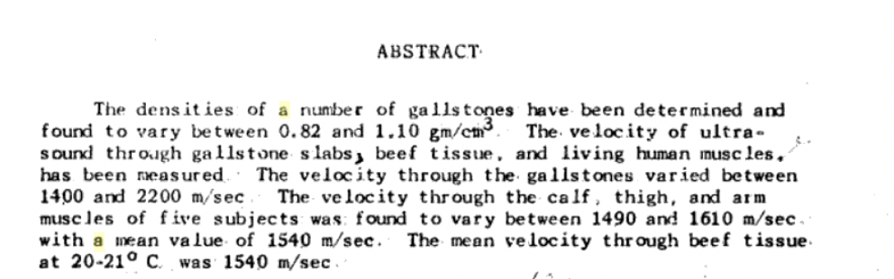
1949

Slide 7
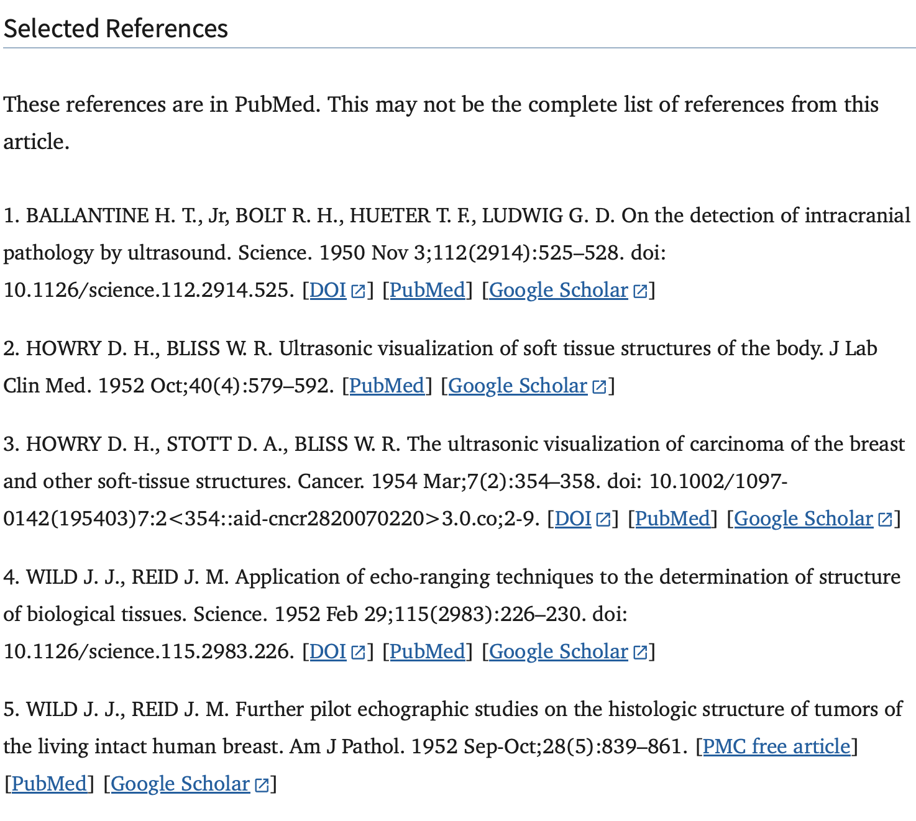
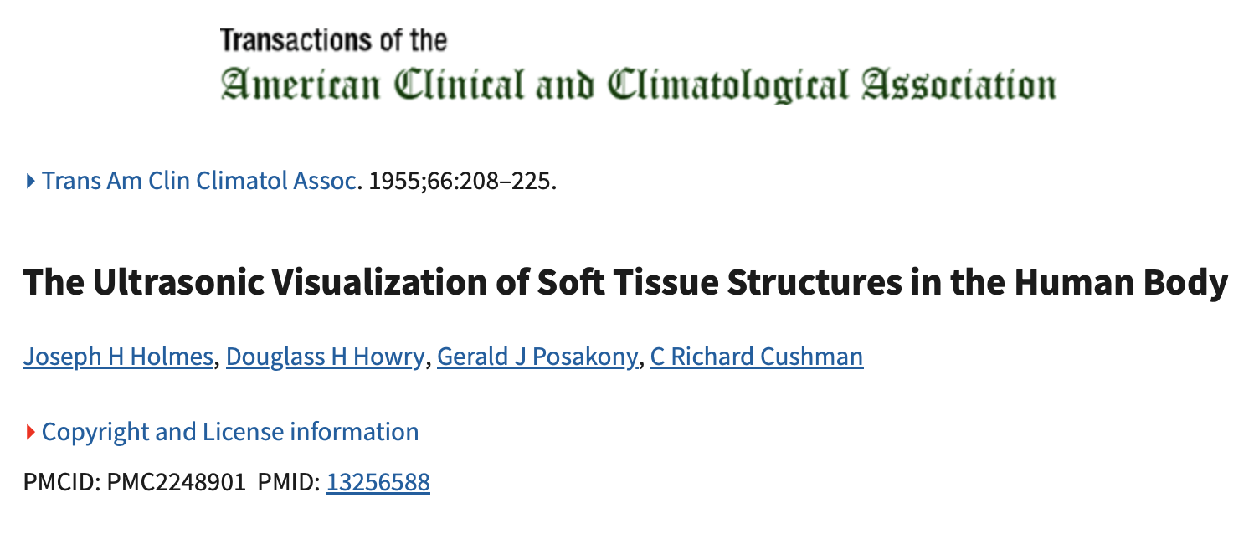
Fifties

Slide 8
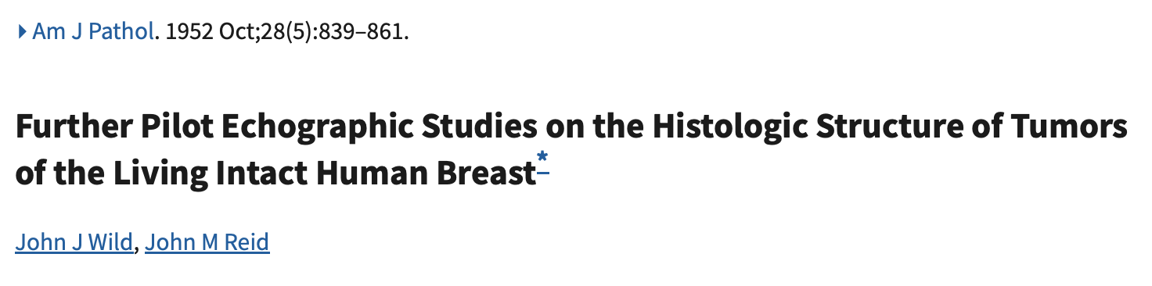
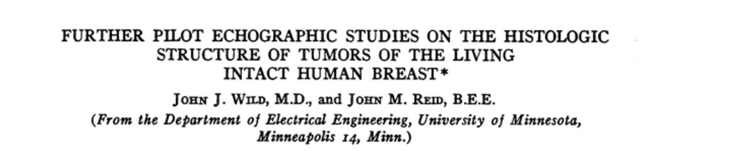
Fifties

Slide 9
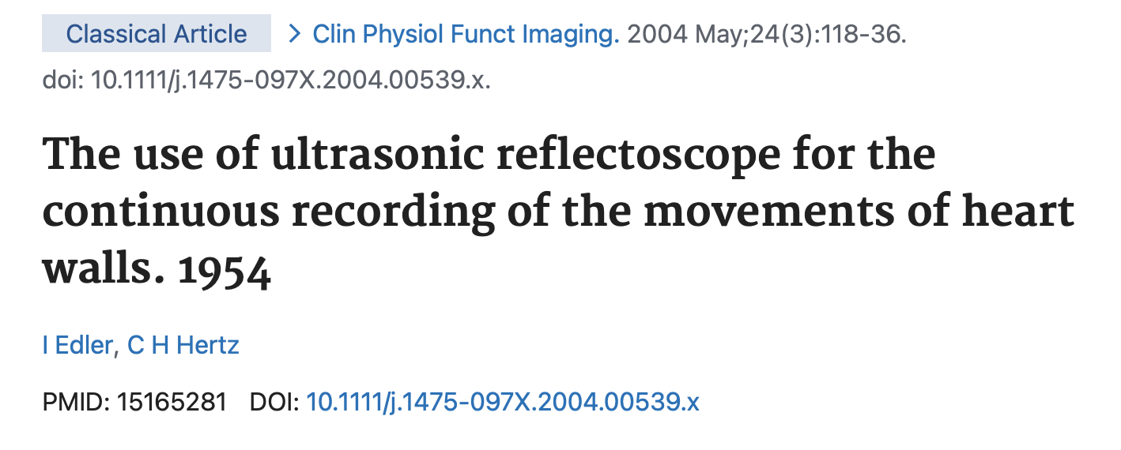
Fifties

Slide 10
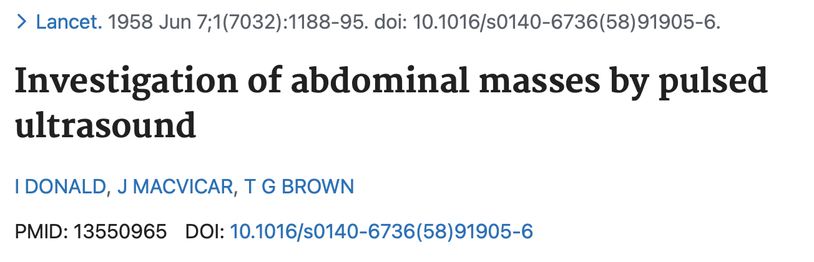
Fifties
Notes:
Donald used ultrasound to detect abdominal tumours and cysts and later was able to detect a twin pregnancy. Ian Donald- "father" of OB-GYN ultrasound.

Slide 11
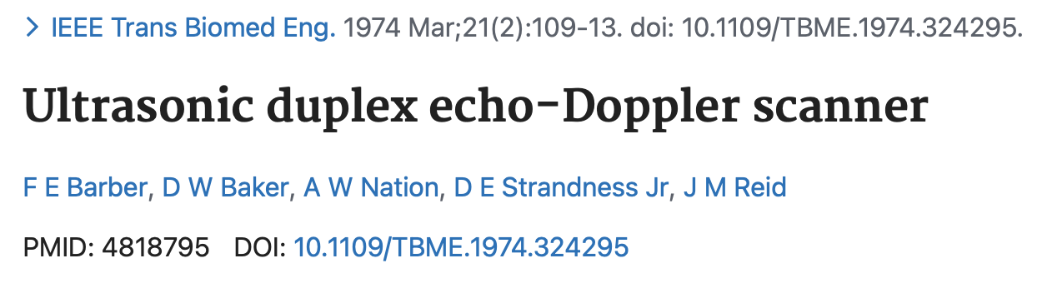

Slide 12

Dedicated Journals/Platforms
Ultrasound in Medicine and Biology
Journal of Ultrasound in Medicine
Ultrasound
International J of US in Medicine and Biology
Journal of Diagnostic Medical Sonography
The Journal of Ultrasound in Clinical Medicine
Ultrasonography
Journal of Ultrasonography
Ultrasound in Obstetrics and Gynaecology
The Ultrasound Journal
Point of care Ultrasound
Journal of Clinical Ultrasound
Ultrasound in Medicine and Biology
Ultrasound International Open
POCUS Journal
Ultrasound sections in “mainstream” journals

Slide 13
Niche areas
Operative Ultrasonography
Cardio-vascular Ultrasound
Journal for Vascular Ultrasound
Endoscopic Ultrasound

Slide 14
Social Media!
YouTube Channels, Blogs/Vlogs

Slide 15
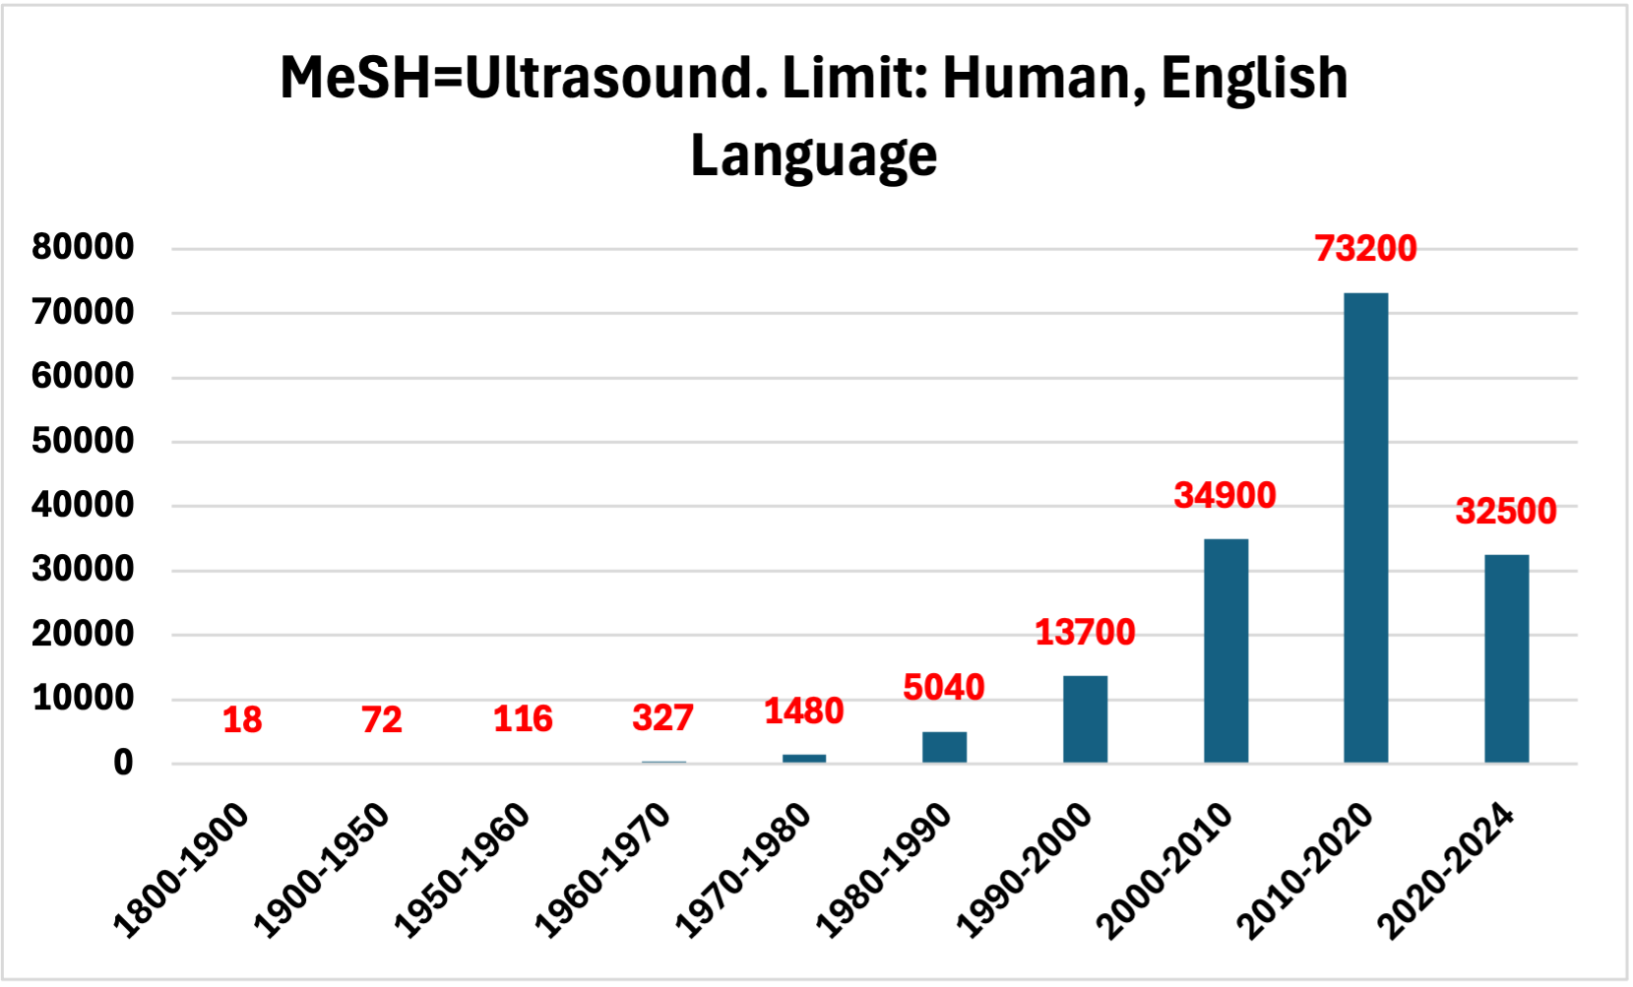
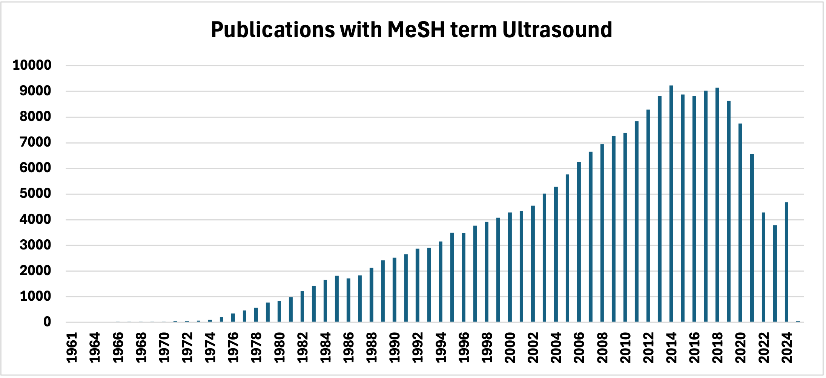
Explosive growth in publications
Medline
Google Scholar
Filters applied: Case Reports, Classical Article, Clinical Study, Clinical Trial, Consensus Development Conference, Guideline, Introductory Journal Article, Meta-Analysis, Multi-center Study, Observational Study, Practice Guideline, Randomized Controlled Trial, Review, Systematic Review.

Slide 16
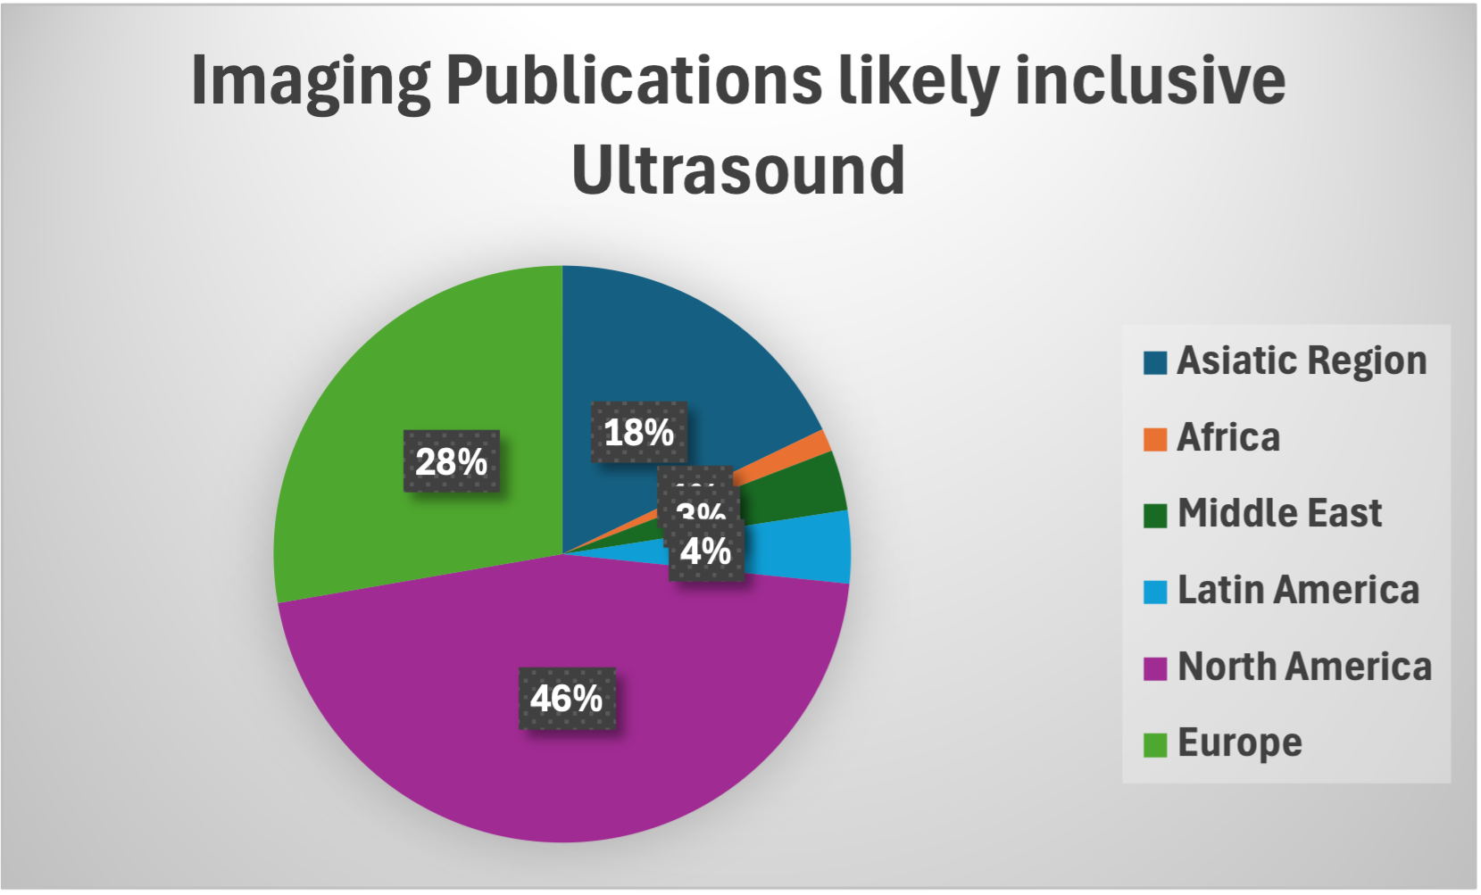
Scimago Country and Journal Rank
Filters:
Medicine
Radiology/Nuclear Medicine/Imaging
2023[2020, 21, 22]

Slide 17
Breath-taking diversity of topics
Point of care Ultrasound for the diagnosis of Retinal detachment-a systematic review and meta-analysis
Tracheal rapid ultrasound examination[TRUE] for confirming emergency tube placement in emergency intubation
Sonography of common tendon injuries
New advances in emergency ultrasound protocols for shock
Early detection of left ventricular diverticulum by Trans thoracic ECHO
A standardised US scoring system for pre-operative prediction of difficult Laparoscopic Cholecystectomy
Renal Cortical Elastography: normal values and variations
Penile Doppler Ultrasonography and elastography evaluation in patients with erectile dysfunction
Use of ultrasound in clarifying the etiology of anal pain
Chorionic bump in first trimester sonography

Slide 18
Measures of “Quality”
Impact Factor
Cite Score
Limited to journals listed in the Web of Science [Clarivate Analytics]
No of citations in a year/ total number of citable documents [articles & reviews only] in the previous two years
Annual Update
Broader Database[ Journals listed in Scopus [Elsevier]]
No of ALL citations received in the last 4 years including current year/No of ALL documents published in those 4 years
Monthly update

Slide 19
Cite Scores and Impact Factors 2023
Source title | CiteScore | Impact Factor
Ultrasound in Obstetrics and Gynecology | 12.3 | 6.1
Ultrasound Journal | 6.8 | 3.6
Echo Research and Practice | 6.7 | 3.2
Ultrasound in Medicine and Biology | 6.2 | 2.4
Journal of Ultrasound in Medicine | 5.1 | 2.1
Ultrasonic Imaging | 5.1 | 2.5
Medical Ultrasonography | 3.2 | 1.3
Journal of Ultrasonography | 2.3 | 1.3
Ultrasound | 1.7 | 0.8
Journal of Diagnostic Medical Sonography | 0.6 | 0.3

Slide 20
Measures of “Quality”
From the Publisher/Editor’s perspective
From the Author/Contributor’s perspective
A high IF/CS
To achieve and sustain this:
A continuing stream of a wide variety of submissions in your chosen academic field
A broad database of “active/committed” reviewers
Submission to final decision as short as possible
A wide readership, a high download rate, a large subscription with a high renewal rate
To be seen as a subject matter expert/attract funding & secure academic titles/positions
To achieve and sustain this:
To publish in a journal with high IF/CS
To publish higher evidence articles
To publish regularly
To be cited widely and frequently [ a high H index]

Slide 21
Quantity or Quality?
From the Editor’s perspective
From the author’s perspective
Quantity underpins quality – freedom to choose guaranteeing quality
Equally, maintaining quality improves credibility thereby attracting quantity
Tools available:
  Focus: Define your area of interest
  Robust peer review
  Do not hesitate to reject/suggest revisions
  Shorten the turnaround time
  A sincere feedback to contributors with a proper explanation
Should you have to wait for your “golden” paper to start off your academic career?
Should you have to wait for Lancet or the NEJM to publish your first paper?
Should rejections/revisions faze you?
Should you have to be the first or sole author before you would start submitting?
Should you have to publish hundreds of articles to get noted or feel good about yourself?

Slide 22


